Slide 1
Smart Cane Project Proposal
Term Project for CNIT581 – ATR
Team Members: Wonse Jo & Shyam Sundar Kannan

Slide 2
Motivation
Approximately
5.5% of Americans 18 to 44 years of age reported having vision loss,
12.0% of Americans 45 to 64 years of age reported having vision loss,
12.2% of Americans 65 to 74 years of age reported having vision loss,
15.2% of Americans 75 years of age and over reported having vision loss. [1]
The persons having vision loss after birth have difficulties in learning to navigate using white cane and the sound produced from it
http://www.afb.org/info/blindness-statistics/adults/special-report-on-aging-and-vision-loss/235

Slide 3
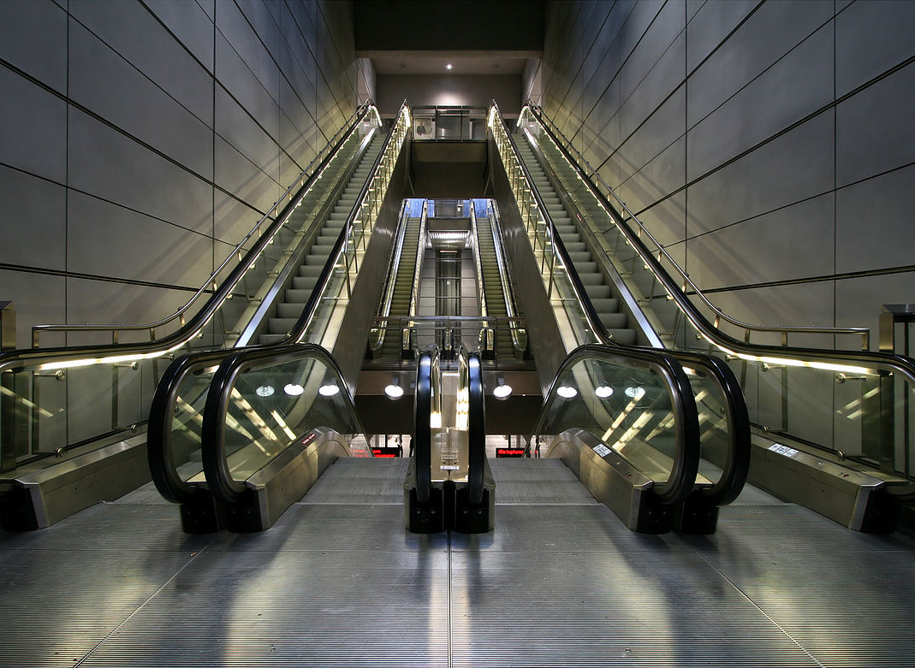
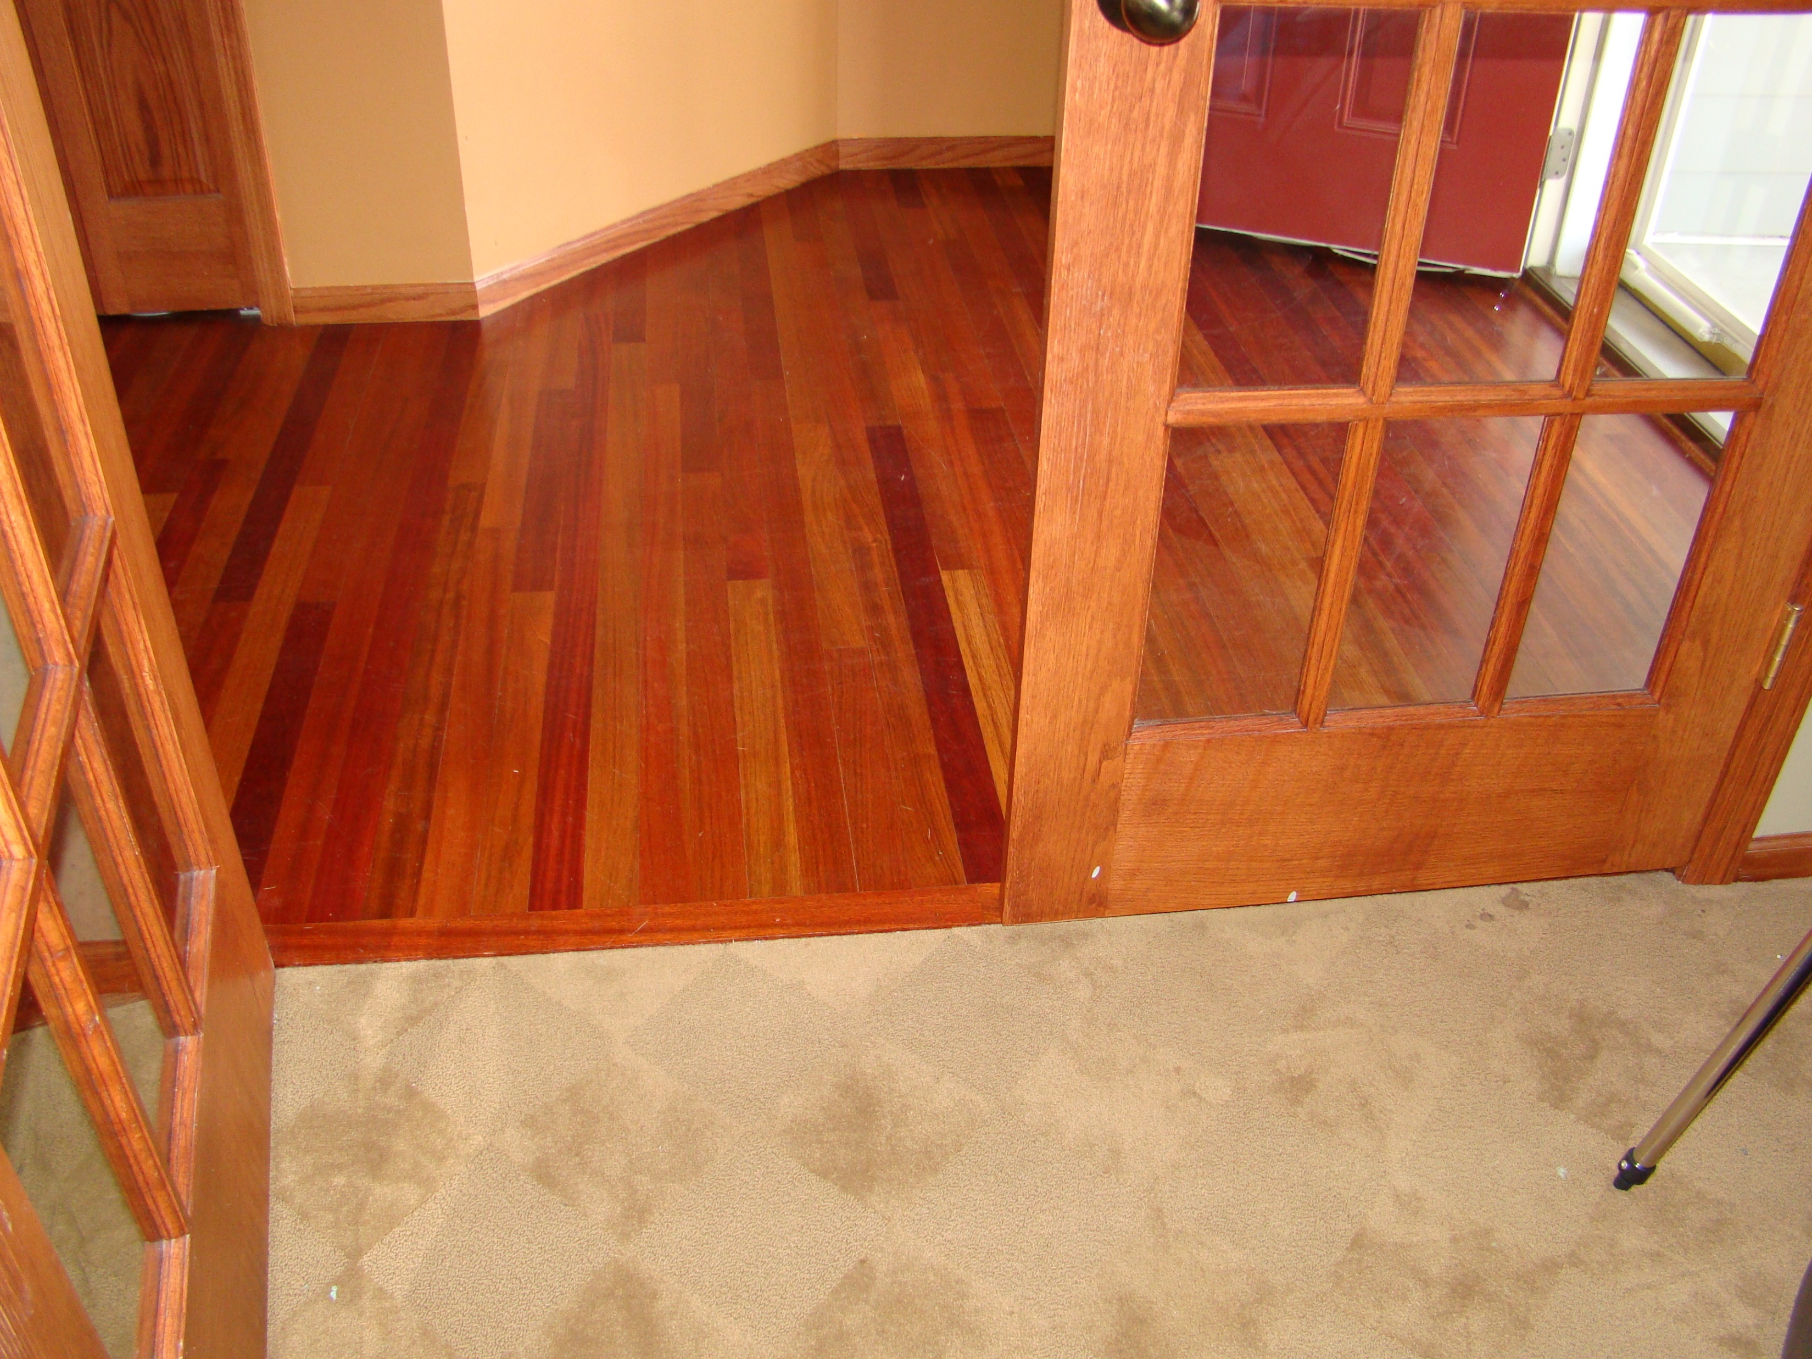
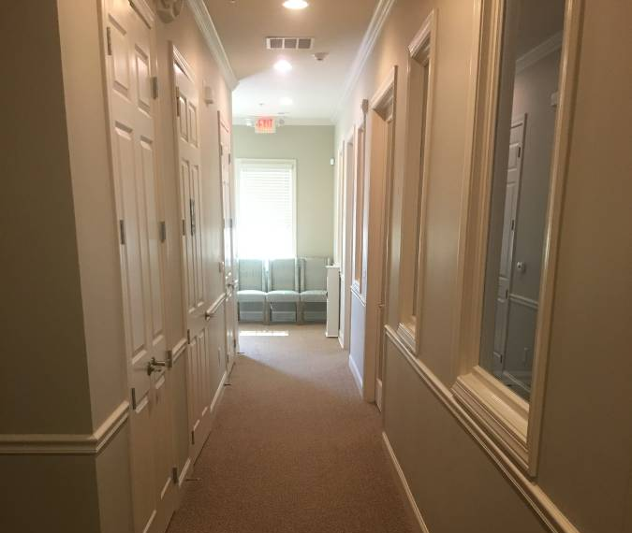
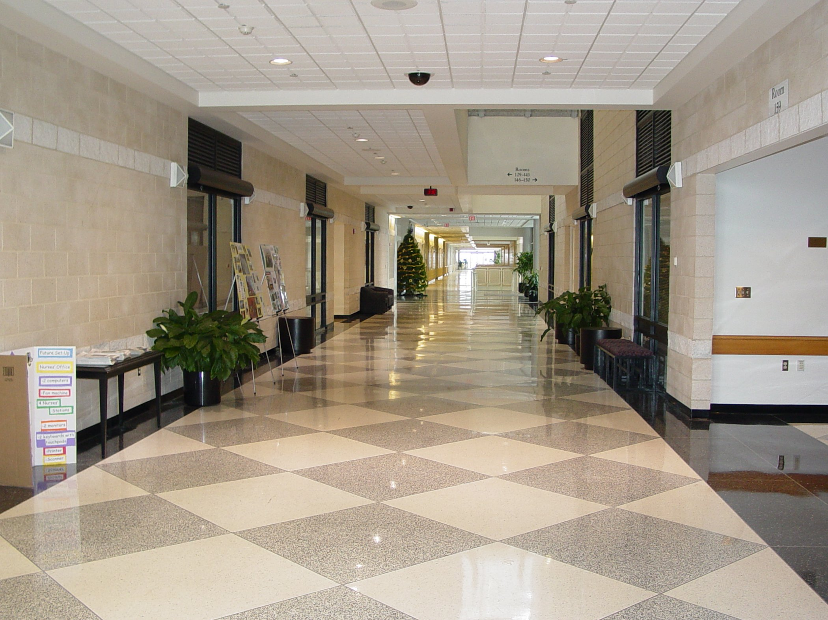
Navigating Indoor

Slide 4
Objective
To build a smart device that can
Keep a track of the material of the floor.
Detect the type of object on the way.
Help find doors in the aisle.
Give independence to the visually challenged in navigating.

Slide 5
Literature Review

Slide 6
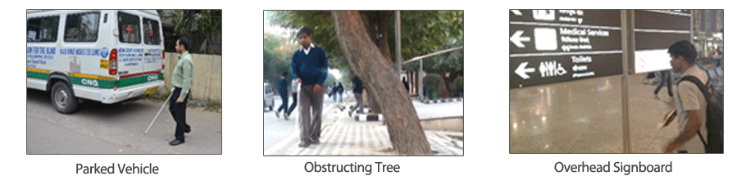
SmartCane Device

Slide 7

Handisco - Sherpa

Slide 8
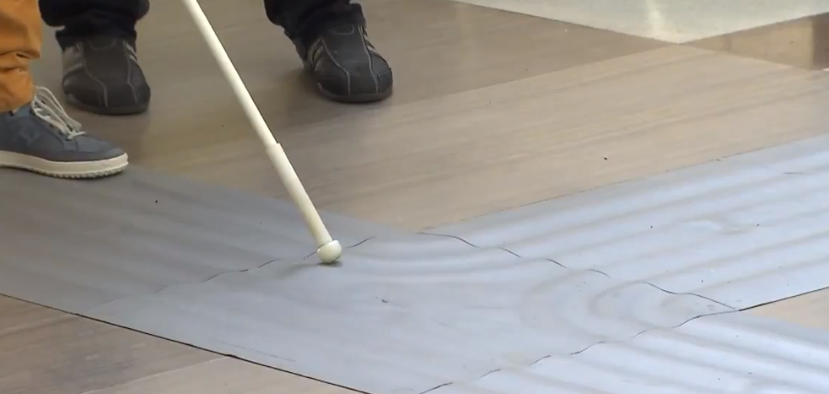
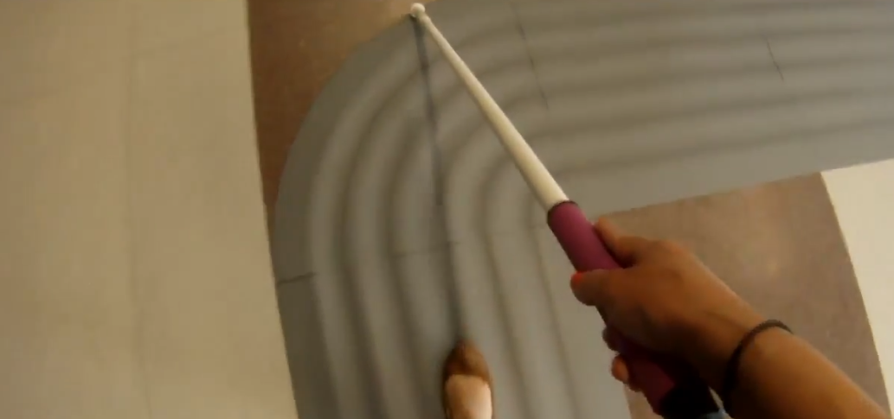
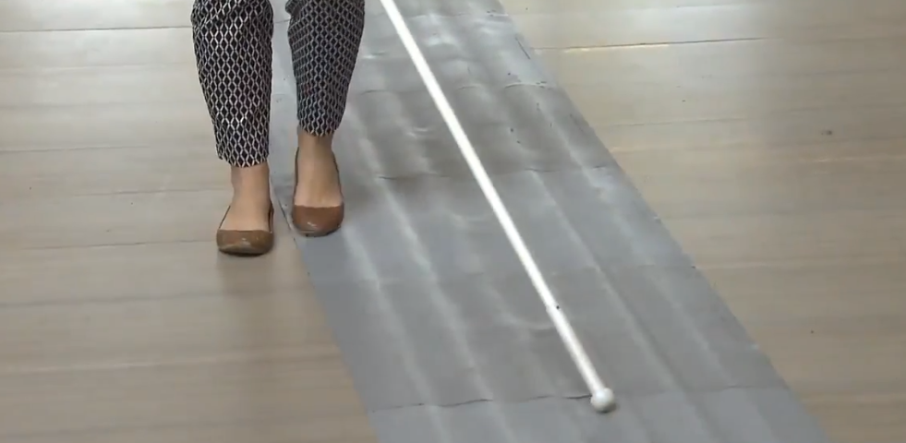
Indoor Path Navigation

Slide 9
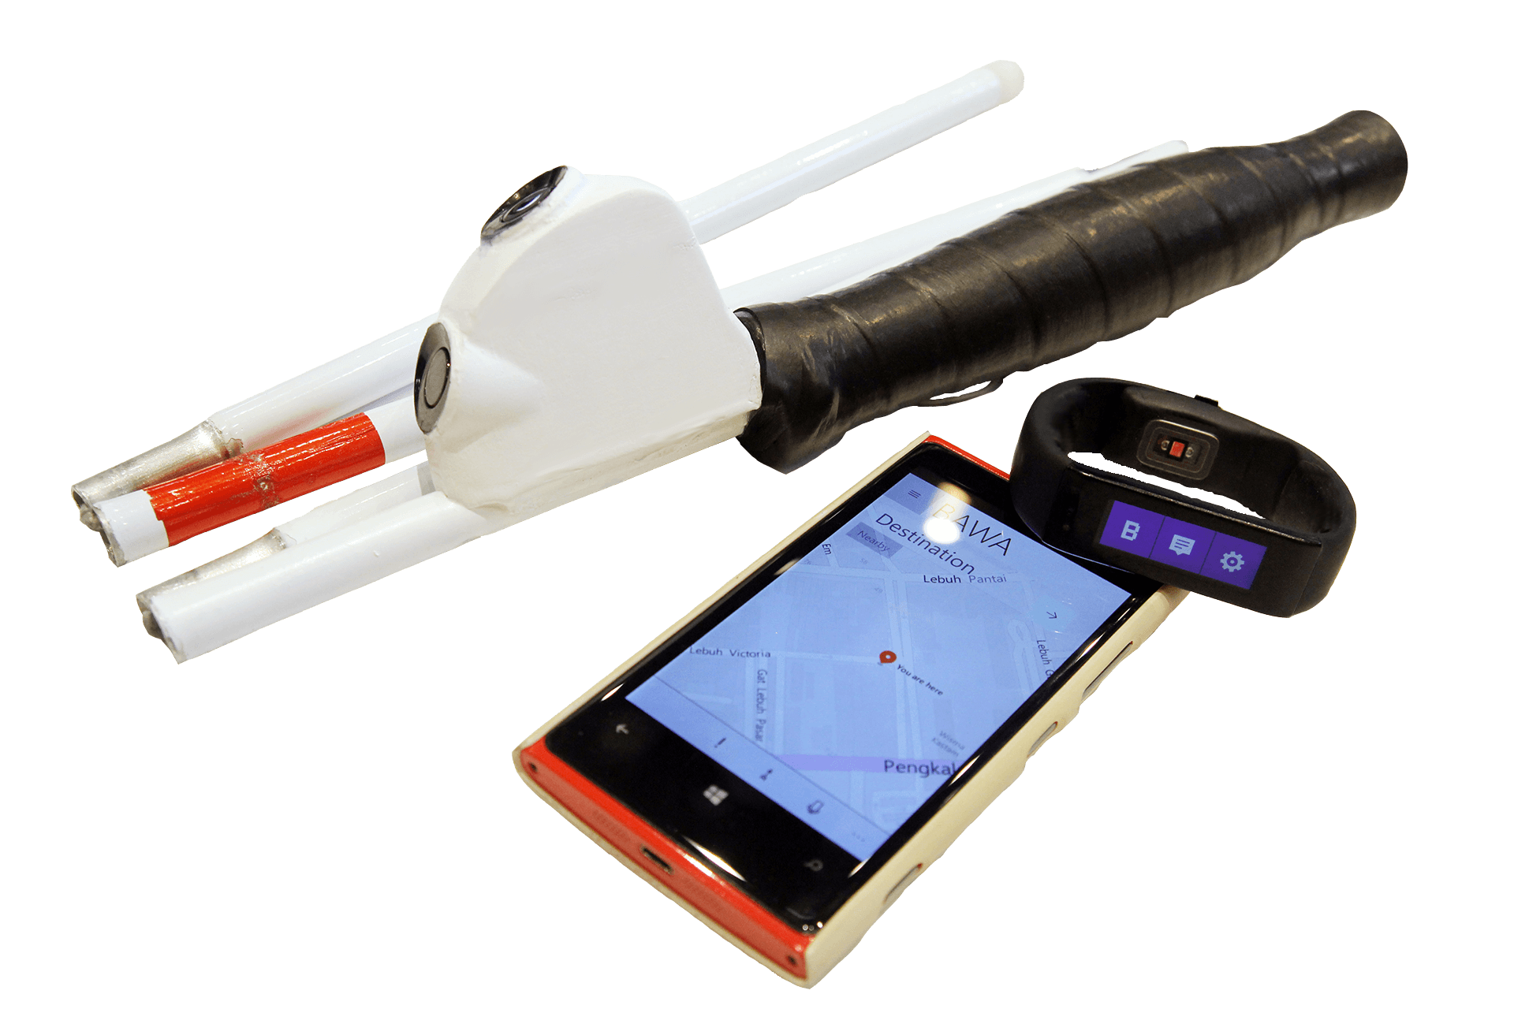
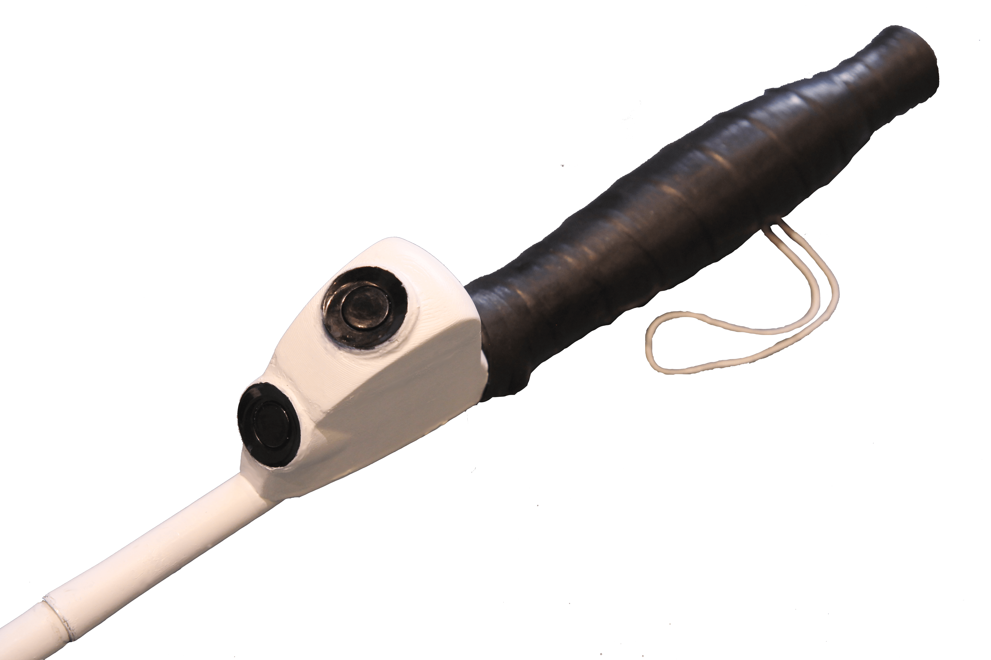
Bawa

Slide 10
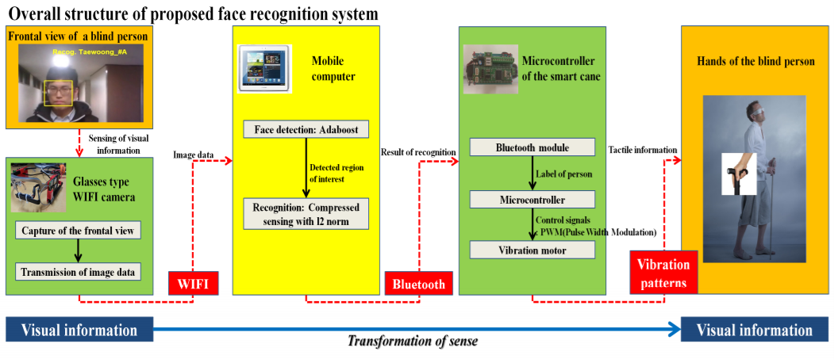
Smart Cane: Face Recognition System for Blind [2]

Slide 11
SmartCane System

Slide 12
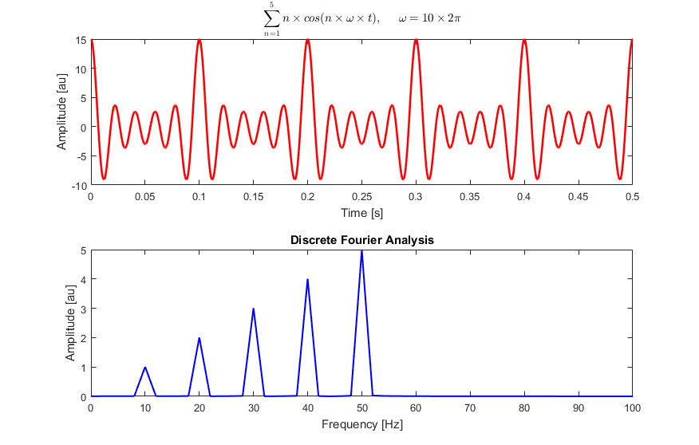
Fast Fourier transform, FFT
Harmonic Frequencies
Peak Frequency
Converts a signal from time domain to a representation in the frequency domain[3]
computes such transformations by factorizing the DFT matrix into a product of sparse factors.
Fast Fourier transforms are widely used for many applications in engineering, science, and mathematics.
[Wikipedia, https://en.wikipedia.org/wiki/Fast_Fourier_transform]

Slide 13
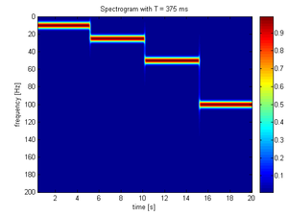
Short-time Fourier transform, STFT
to determine the frequency and phase content of local sections of a signal as it changes over time or real-time[4]
To divide a longer time signal into shorter segments of equal length and then compute the Fourier transform separately on each shorter segment
This reveals the Fourier spectrum on each shorter segment
One then usually plots the changing spectra as a function of time
[Wikipedia, https://en.wikipedia.org/wiki/Short-time_Fourier_transform]

Slide 14
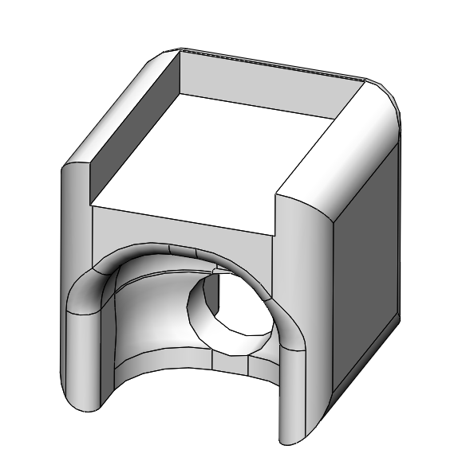
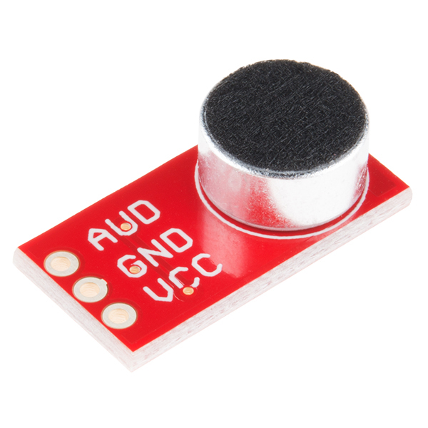
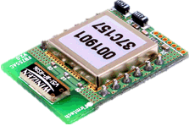
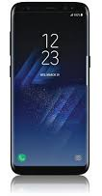
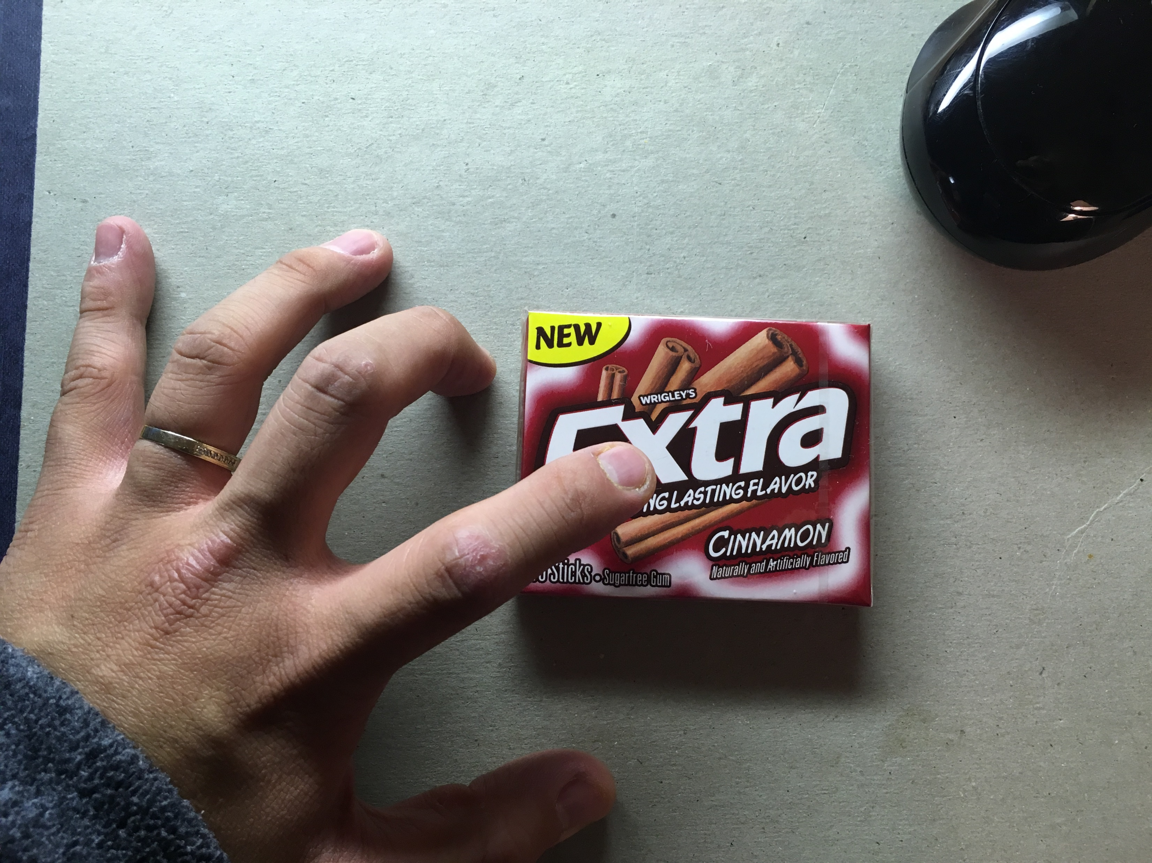



SmartCane System
This is Paper Box, Cinnamon Gum, approximate 80%
Figure 2. Configuration of the recording system
Record
rapping sound
Sound
Smart Phone
ADC
(4000Hz)
Notification for the User
STFT
FFT
(30Hz)
Decide type of obstacles
Freq./Mag.
Bluetooth
Data Analysis
Recoding System
STM32F4
(32bit MCU)
Smart Phone
(Android)
Web Server
Figure 1. Illustration of the proposed the SmartCane
Figure 3. the system block diagram

Slide 15
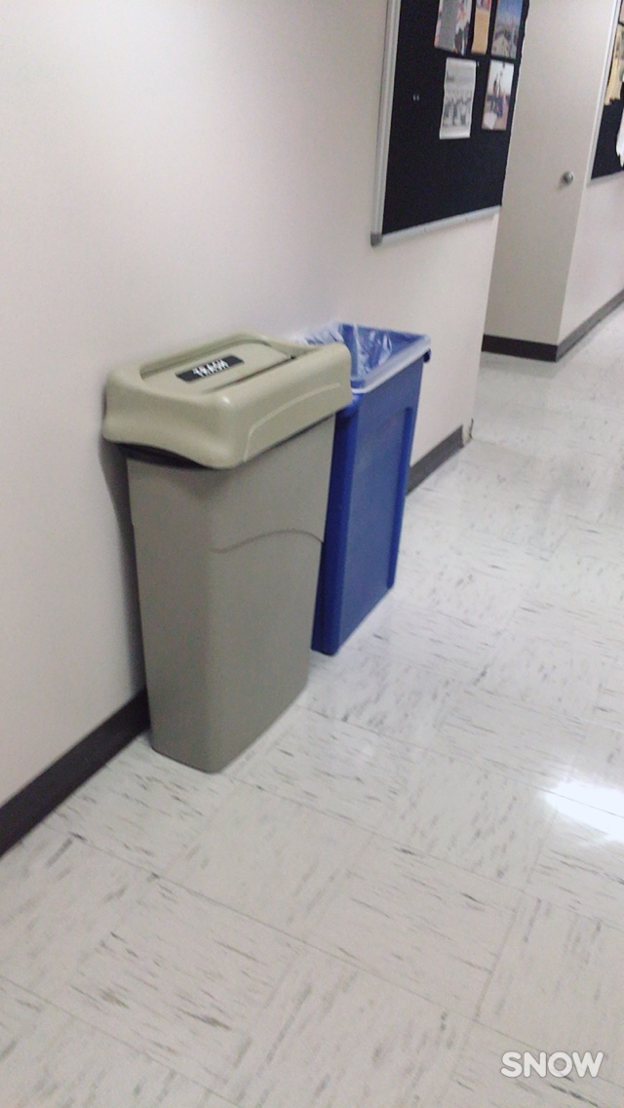
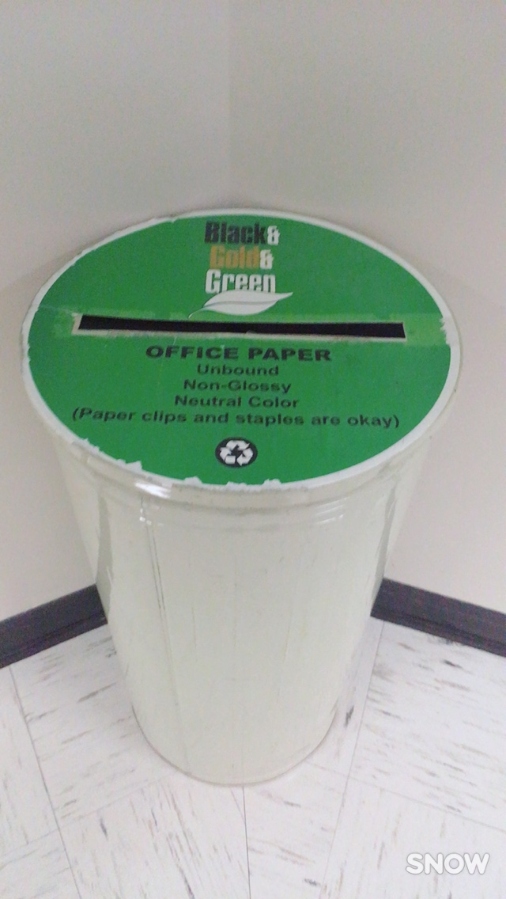
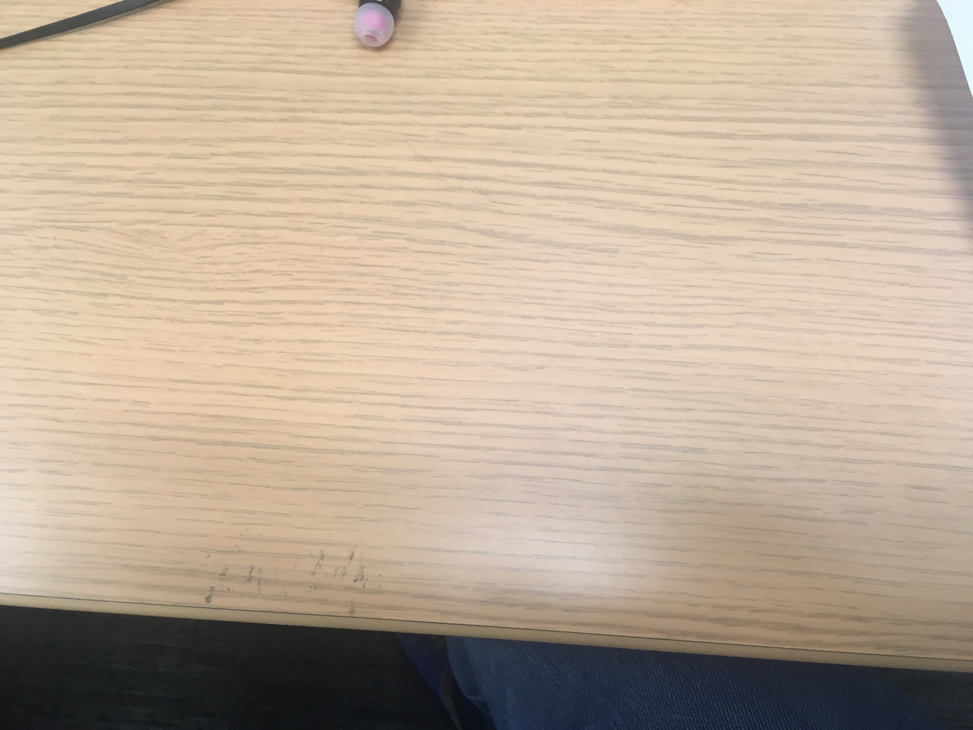
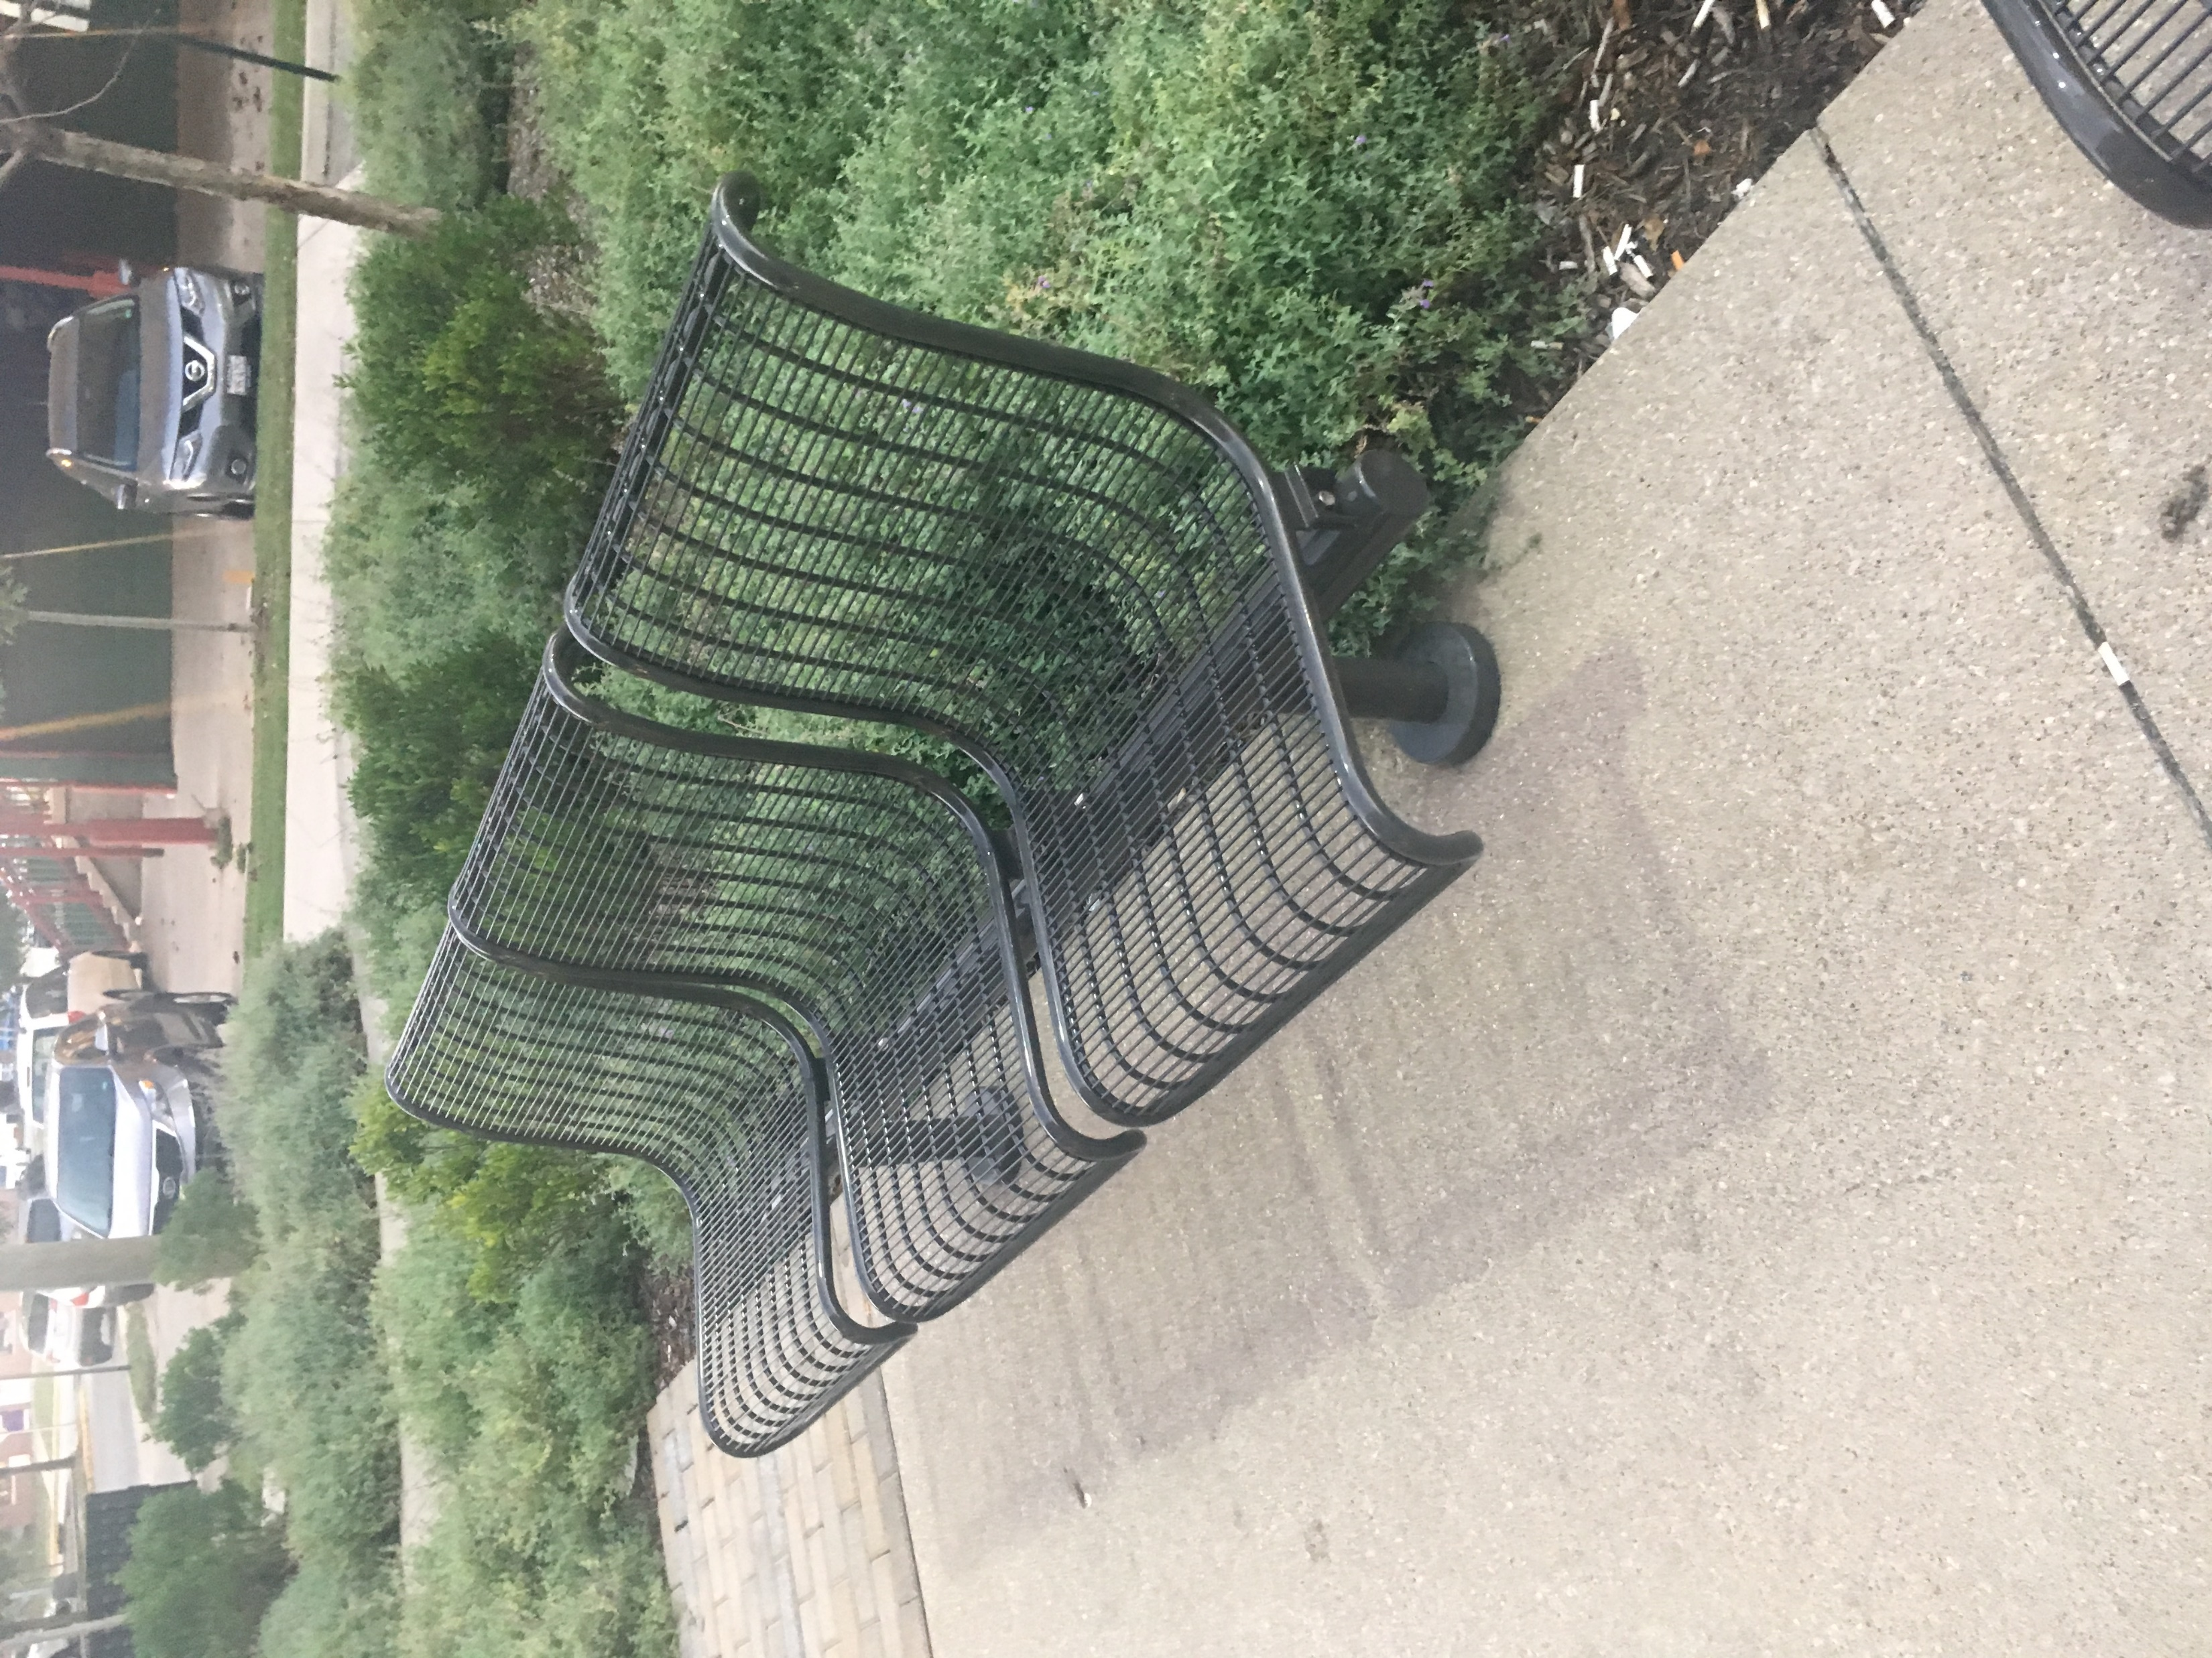
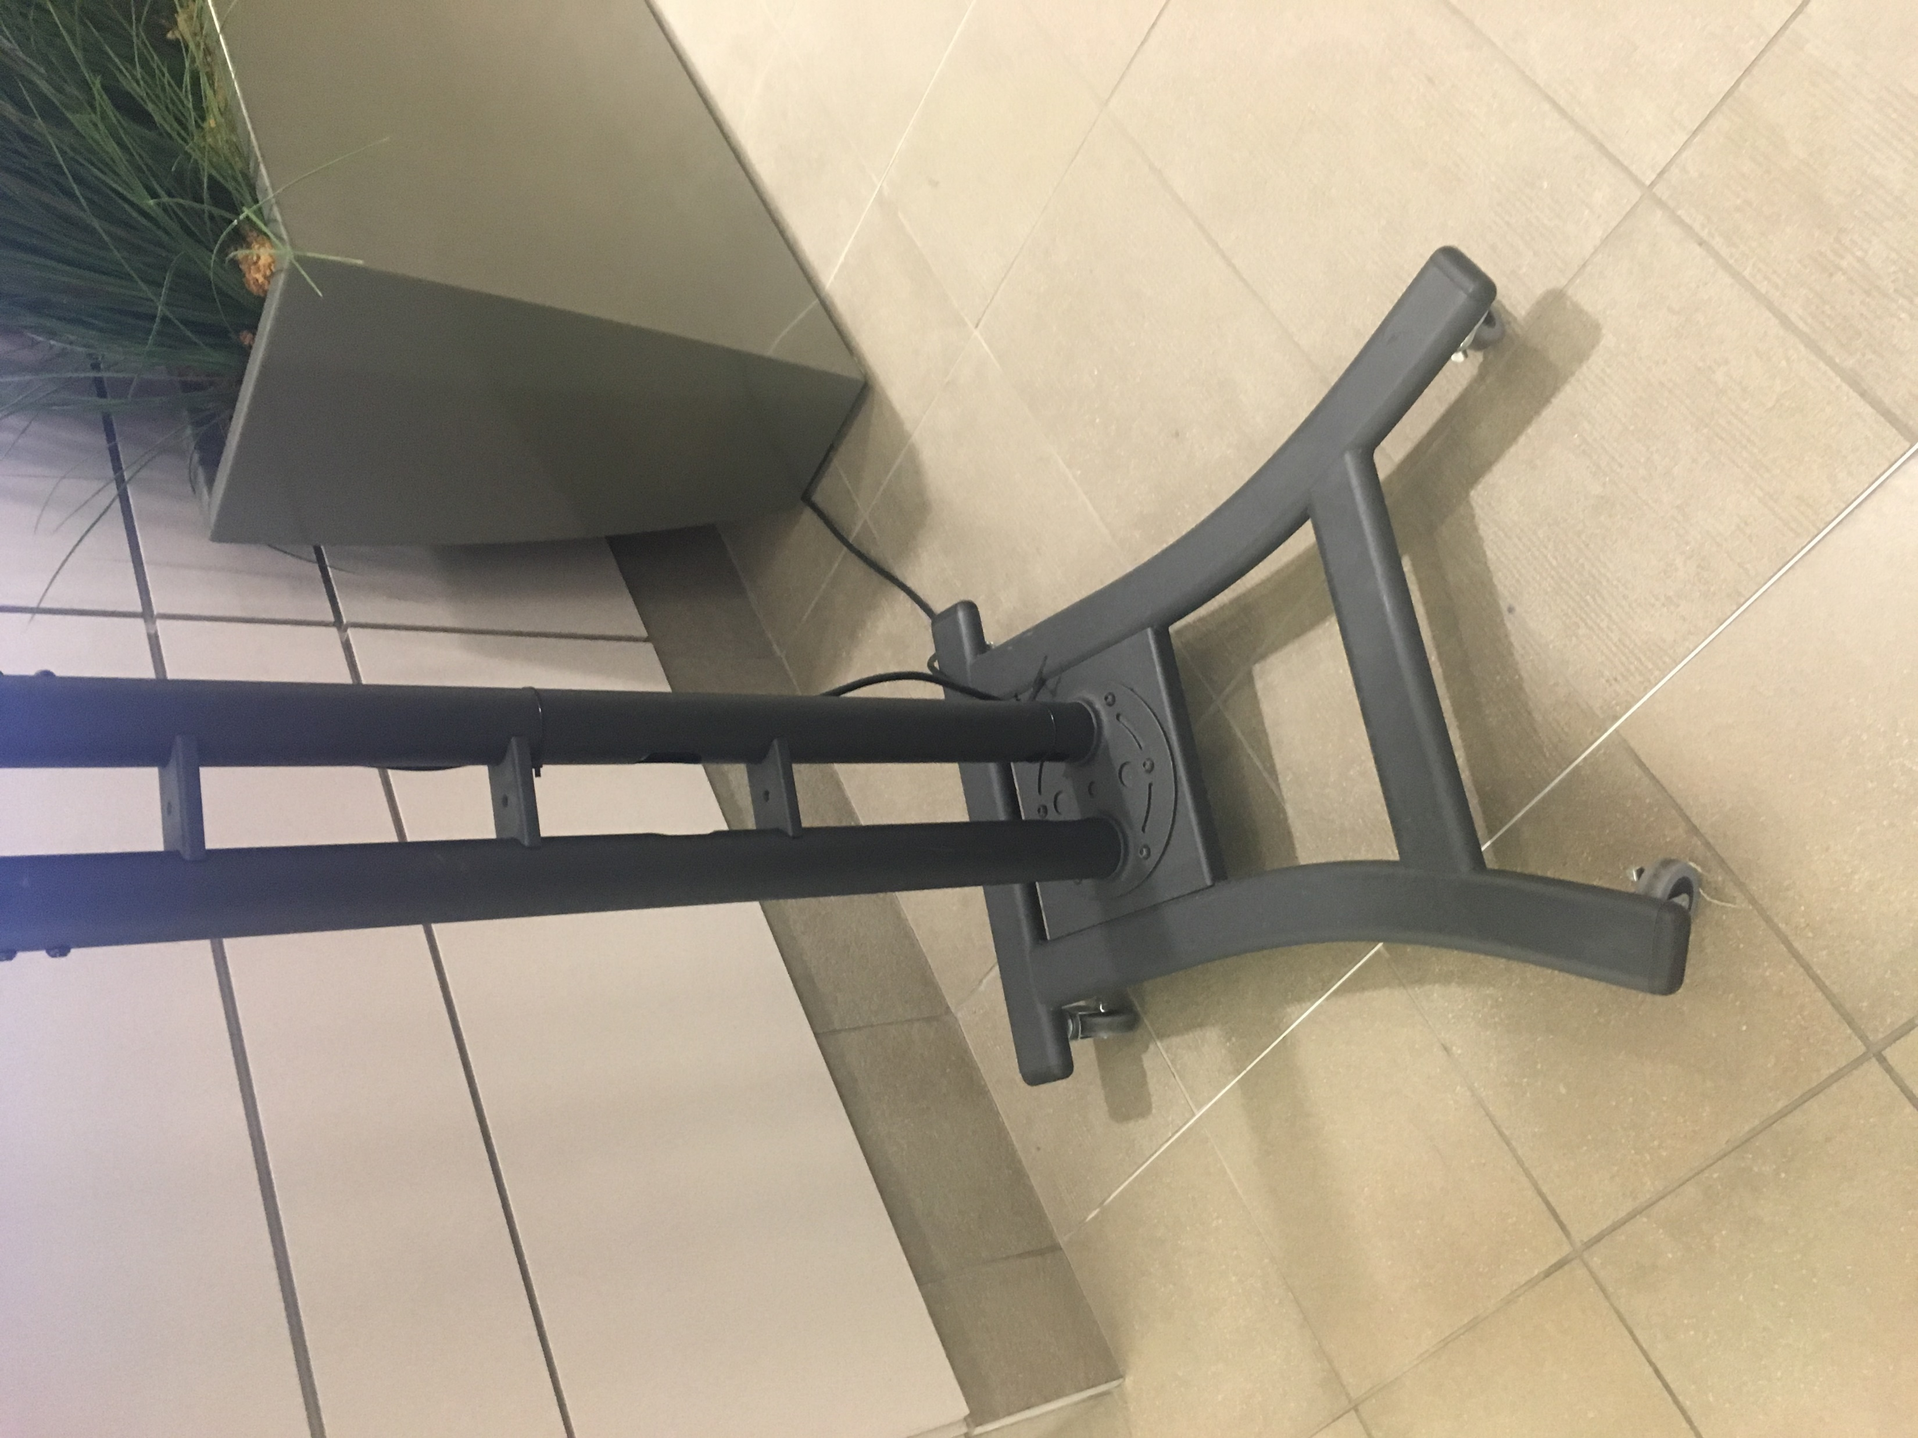
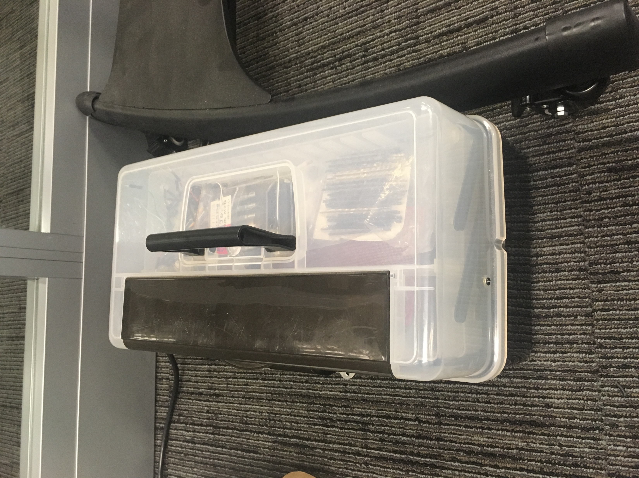
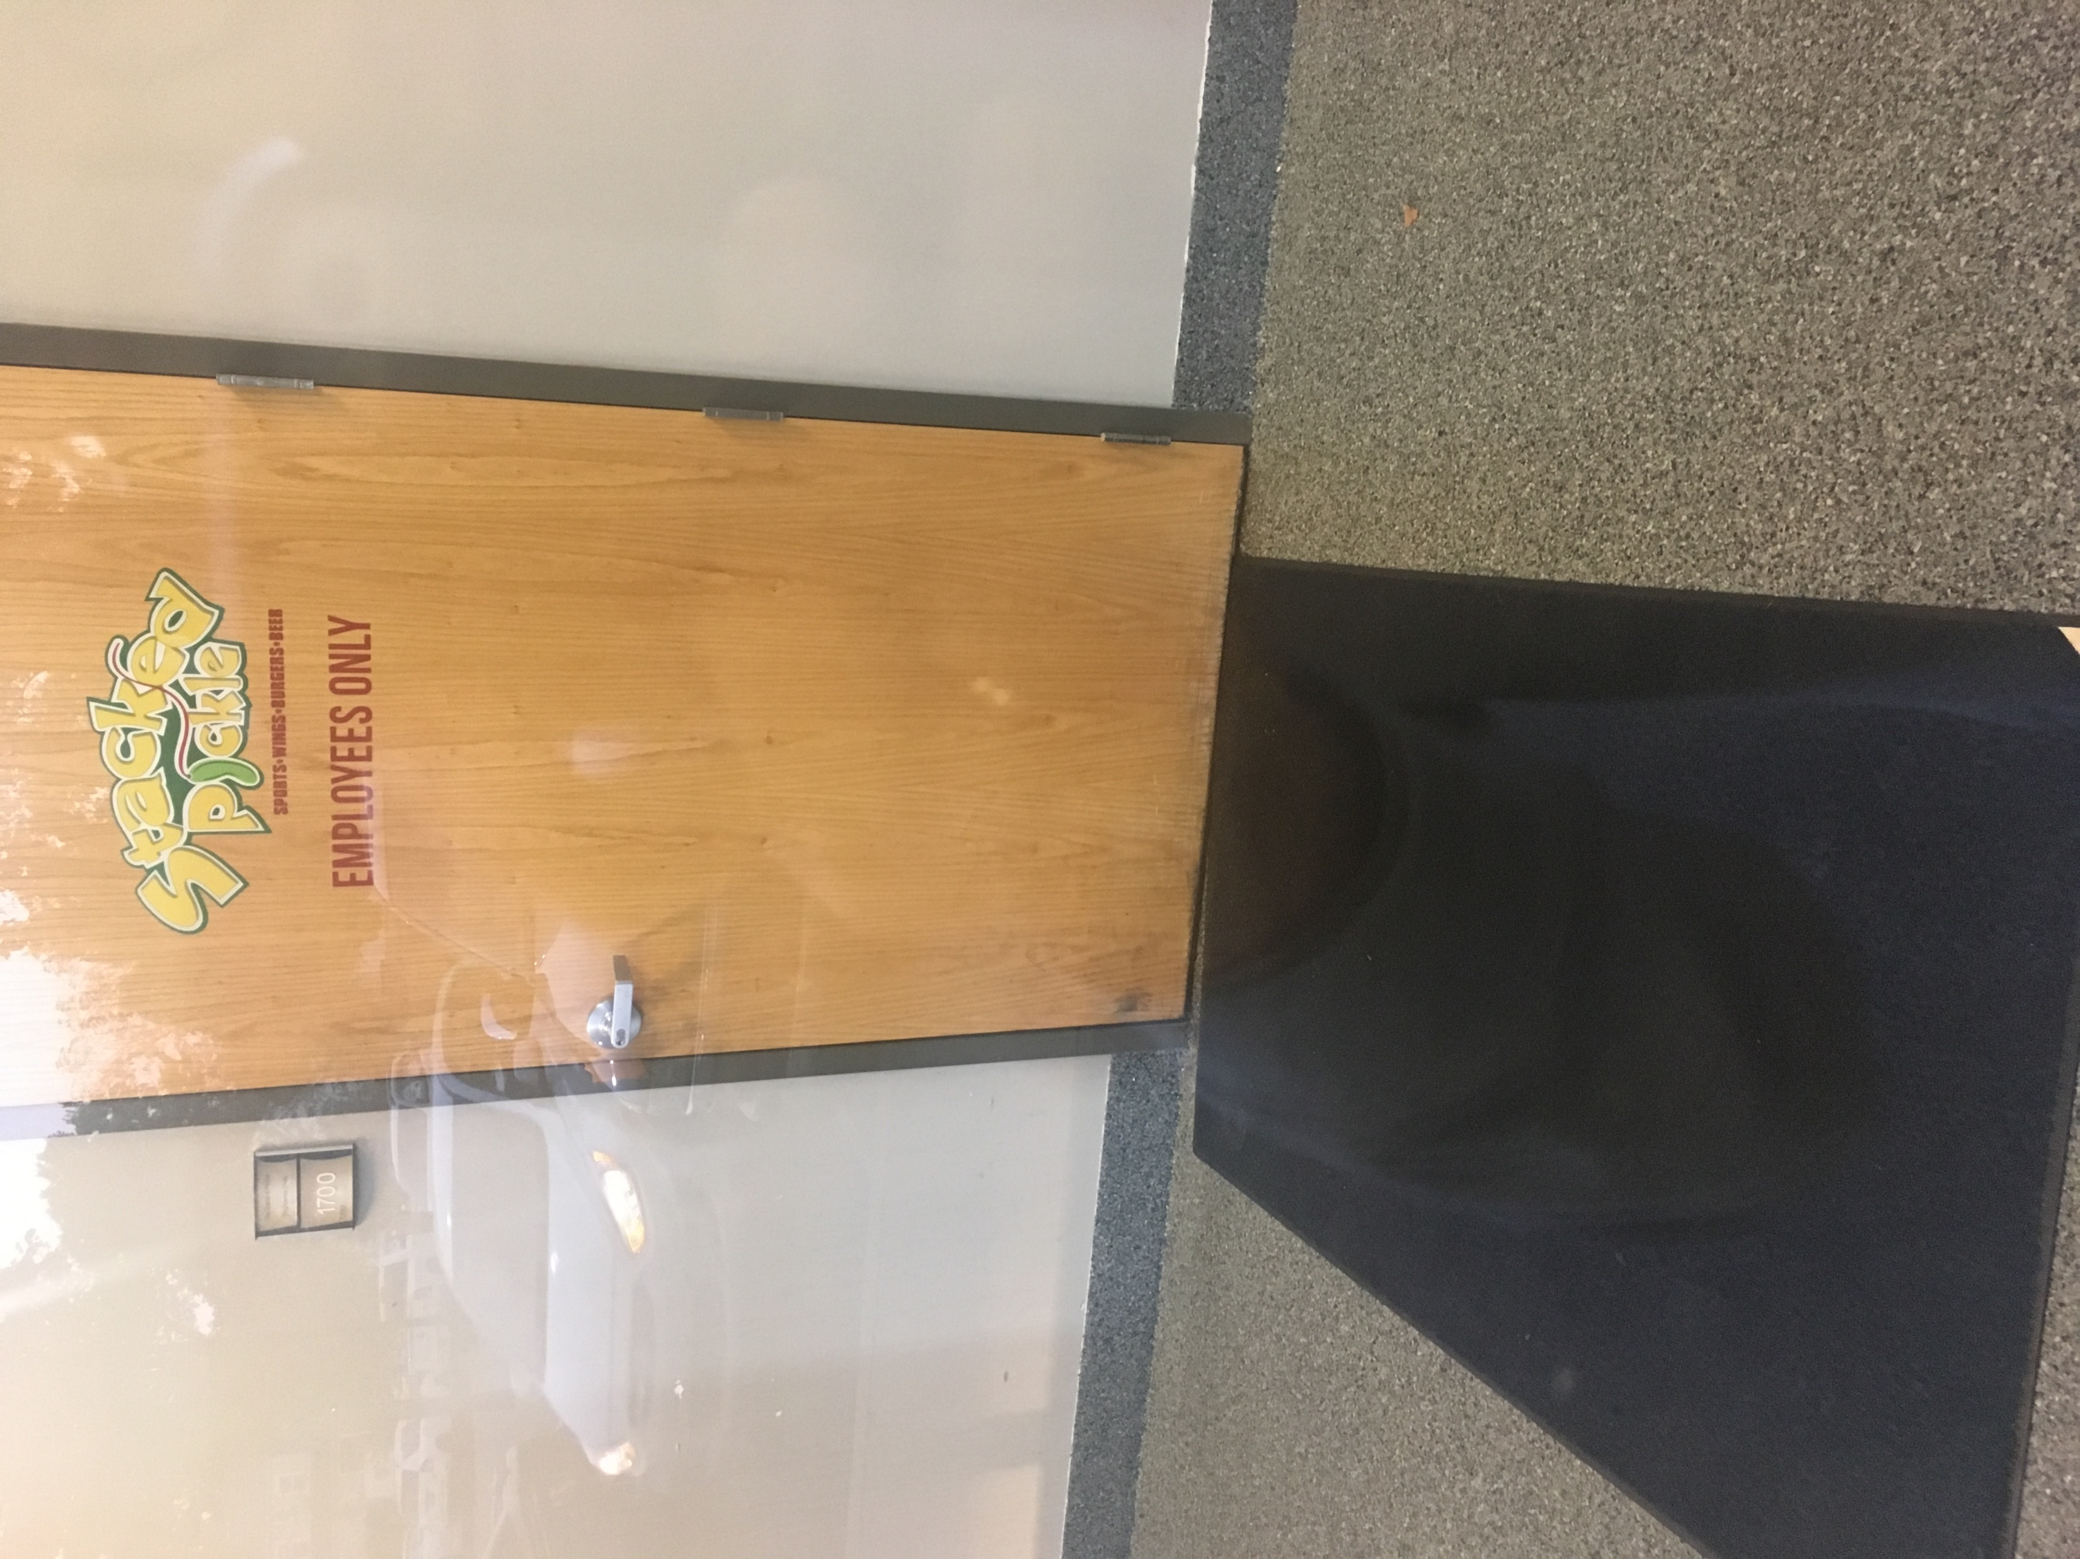
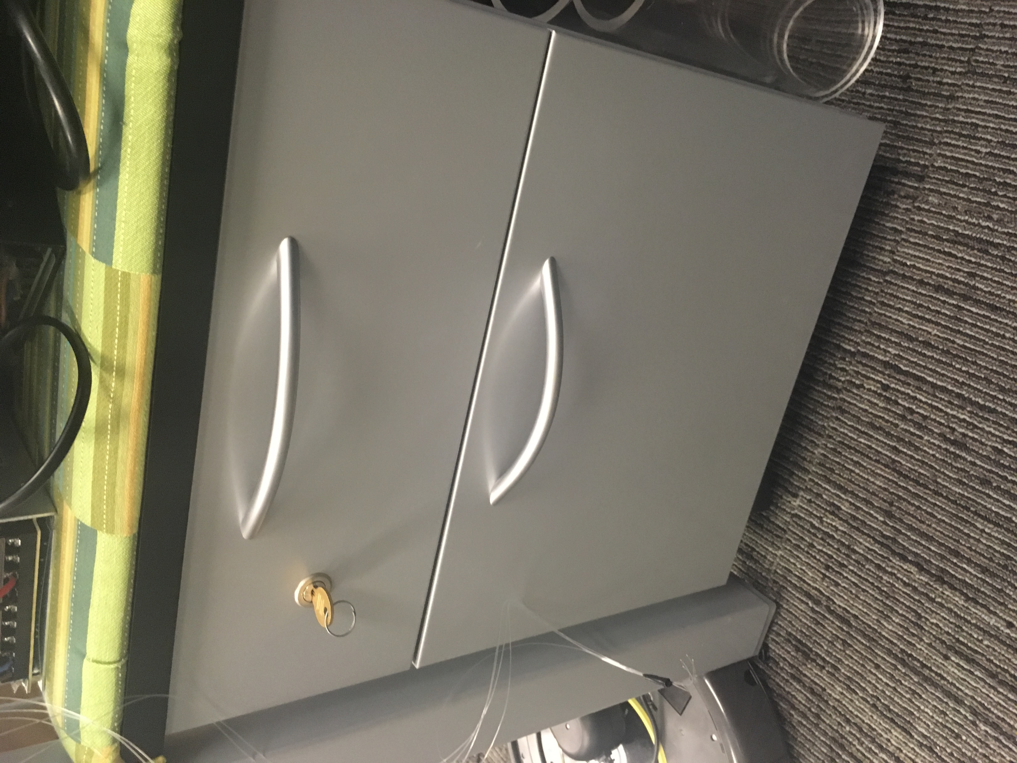
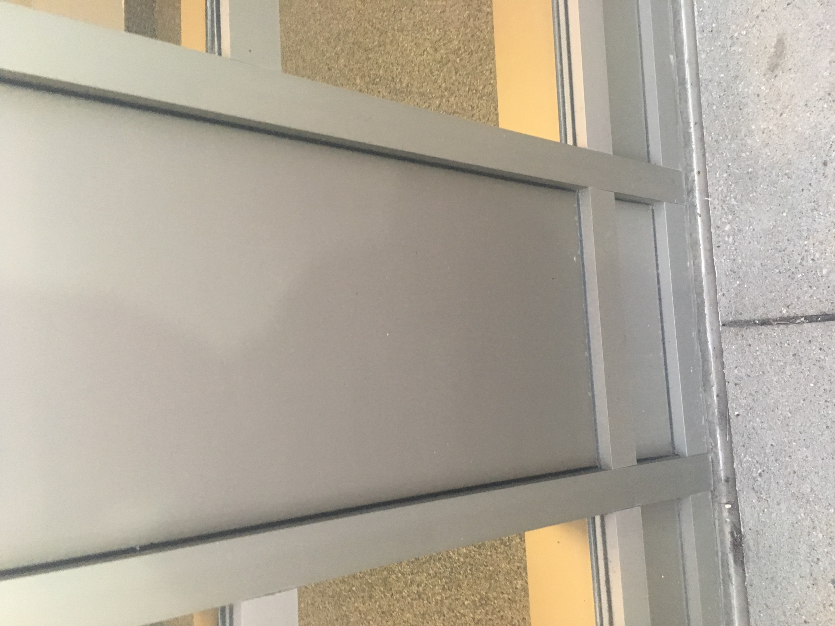
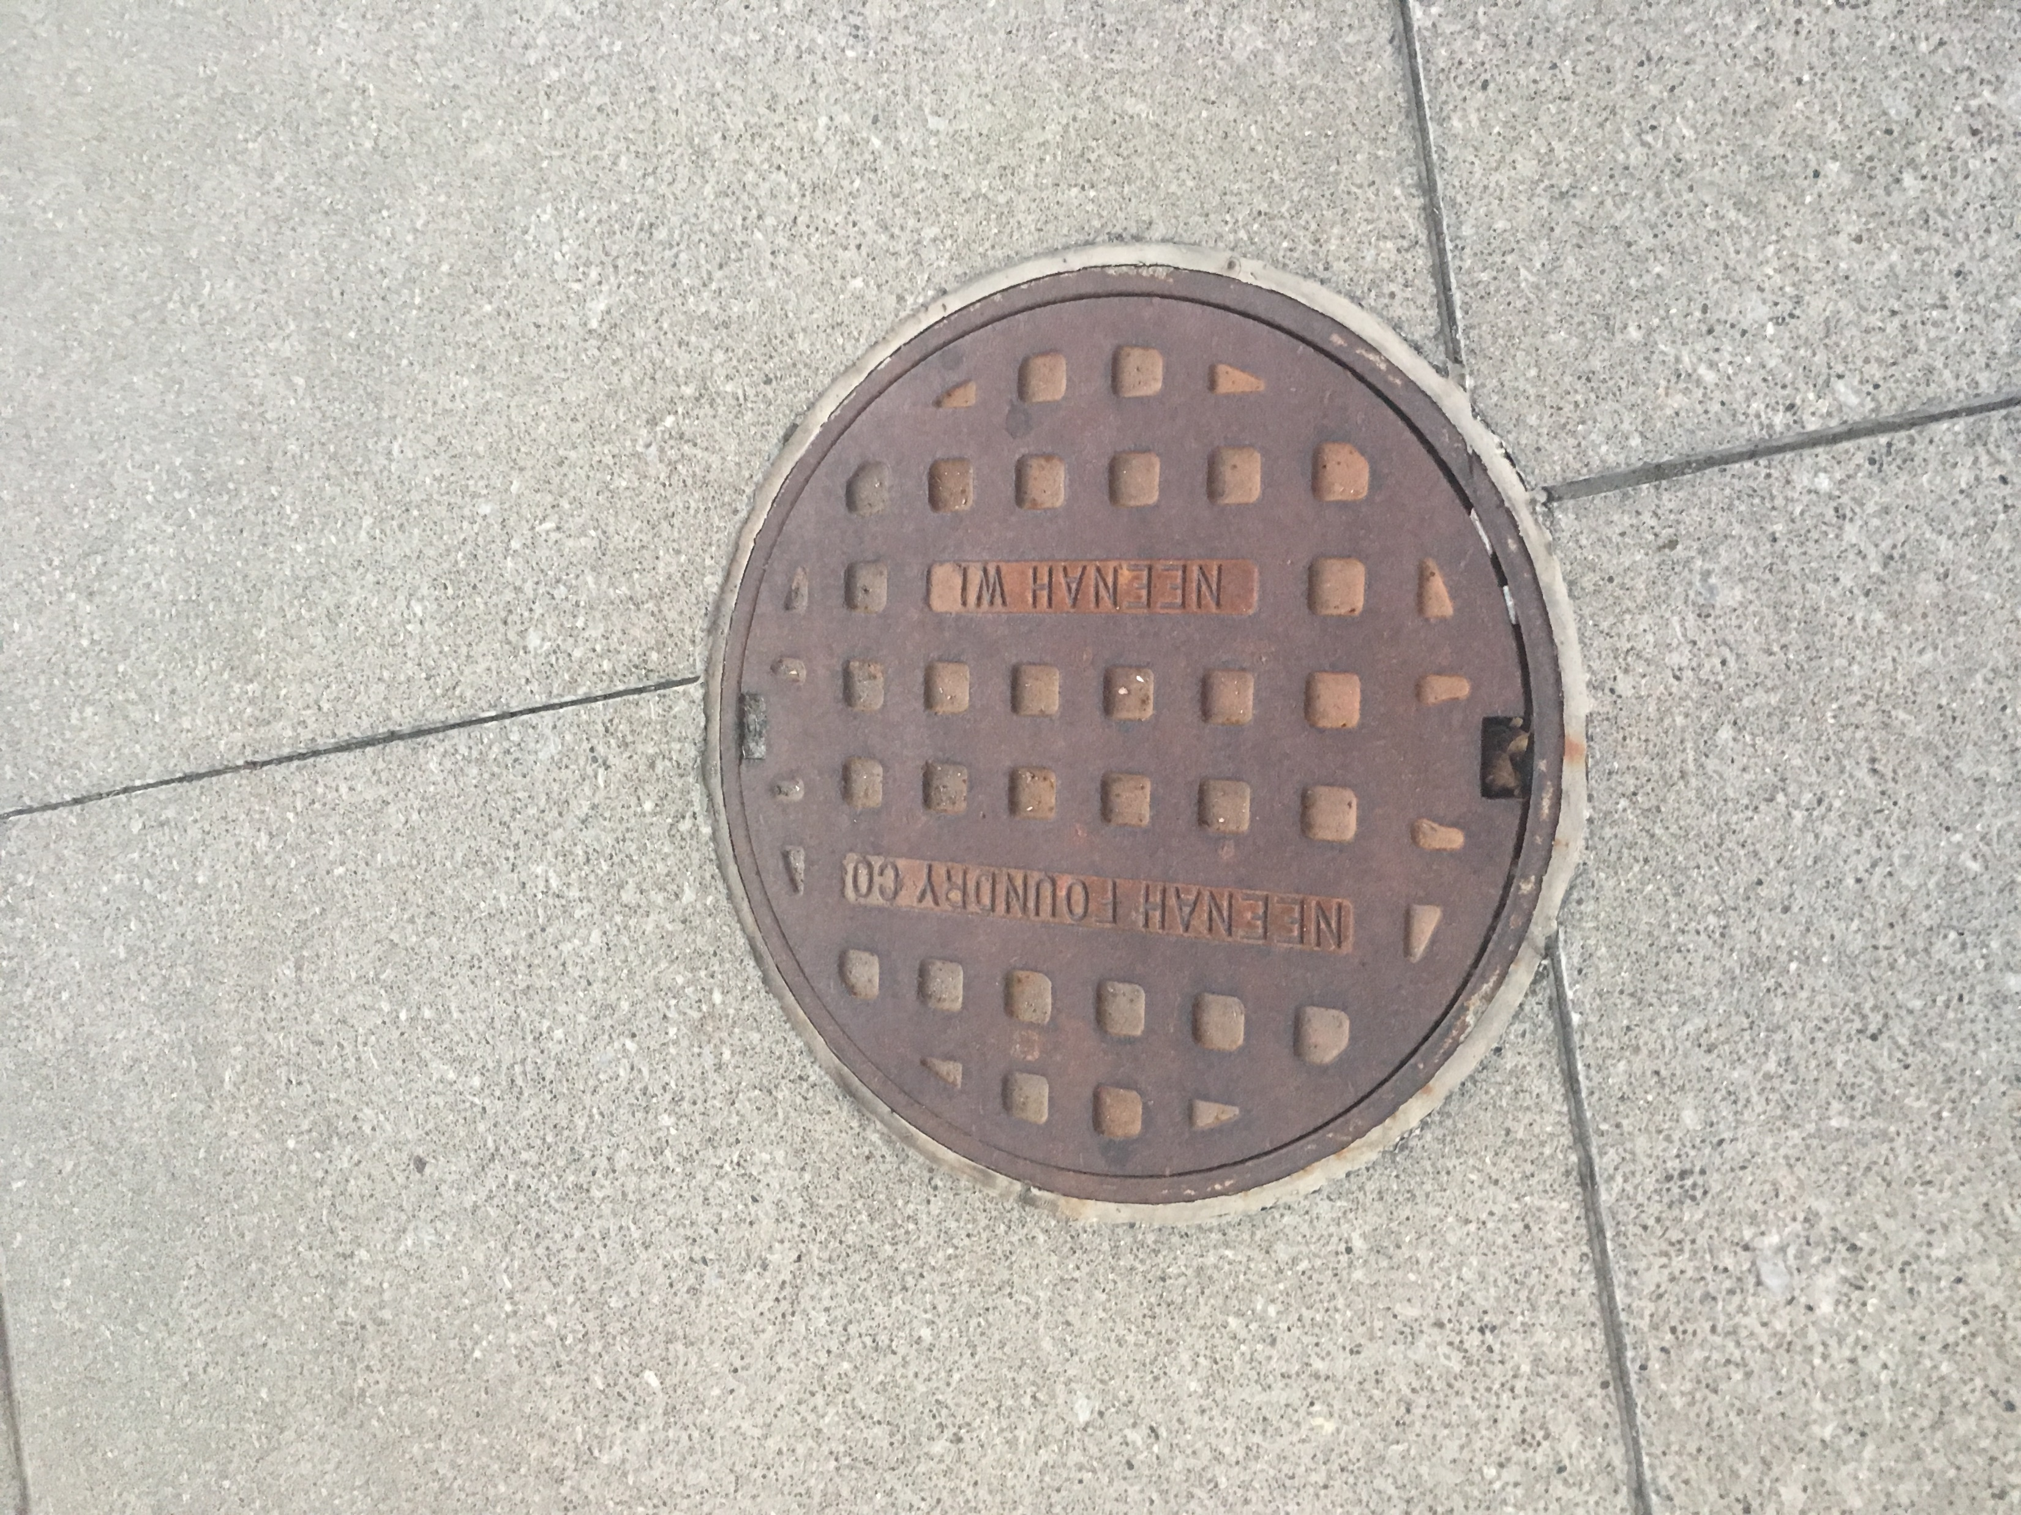
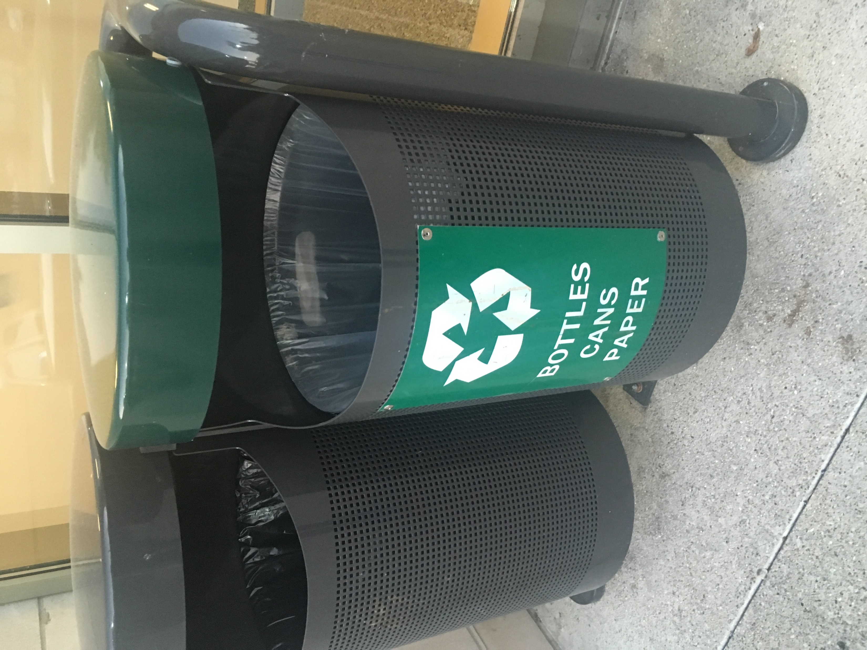
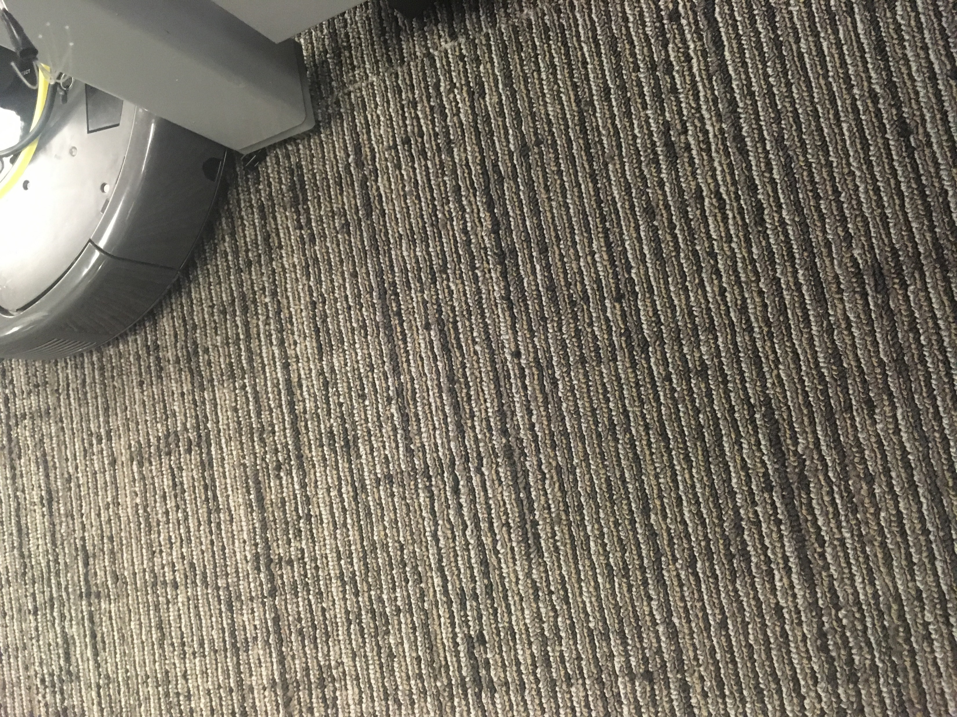
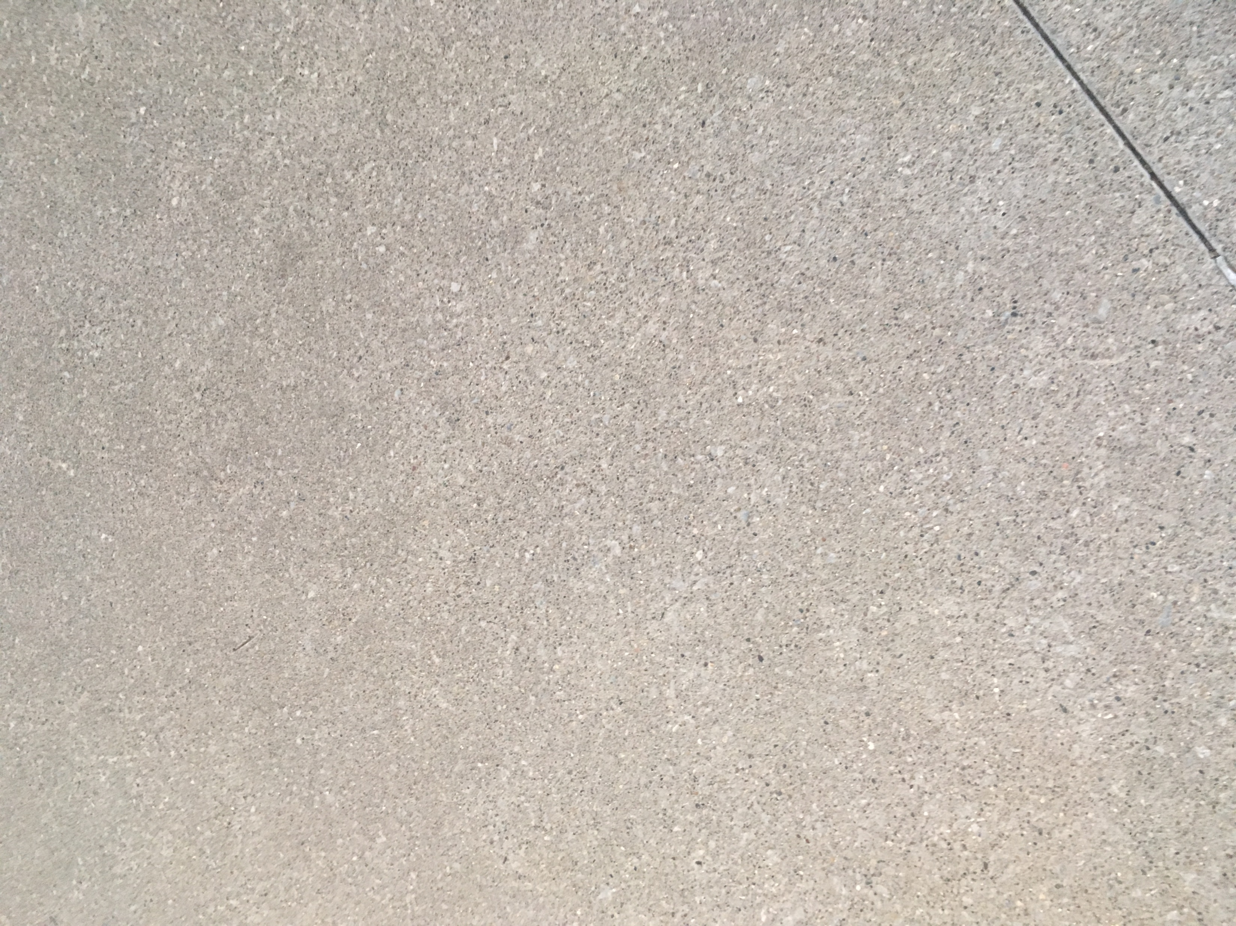
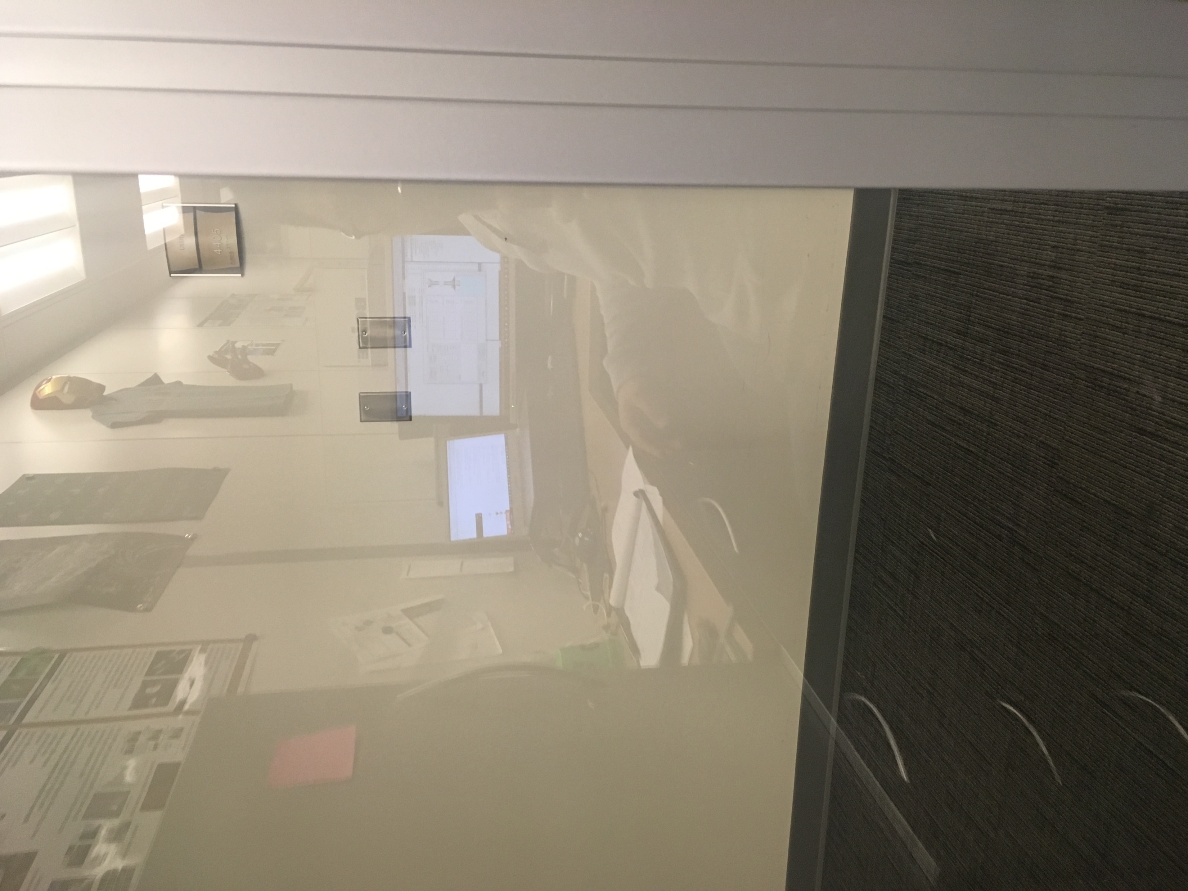
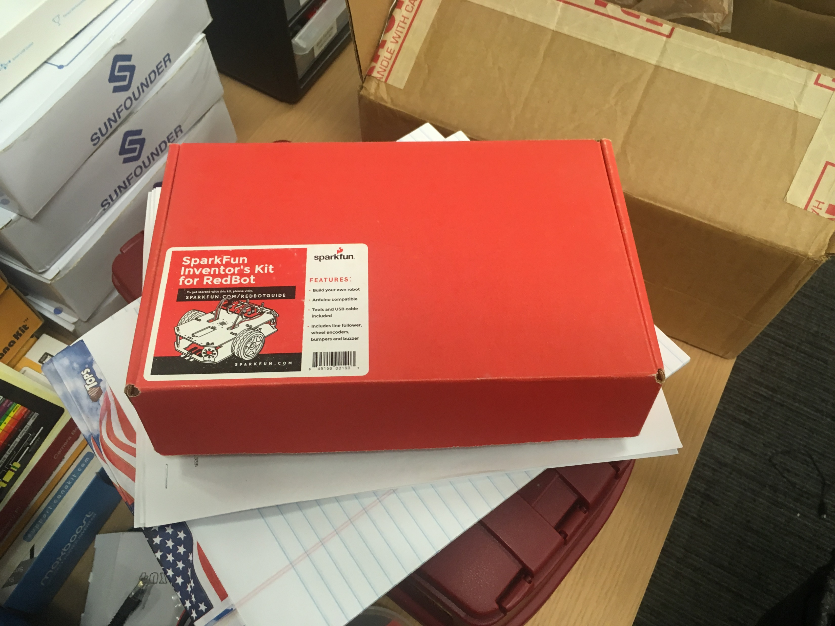
Survey common types of obstacles
Metal(7+)
Plastic(2+)
Wood(2+)
Cotton(1+)
Stone(1+)
Glass(2+)
Paper(1+)

Slide 16
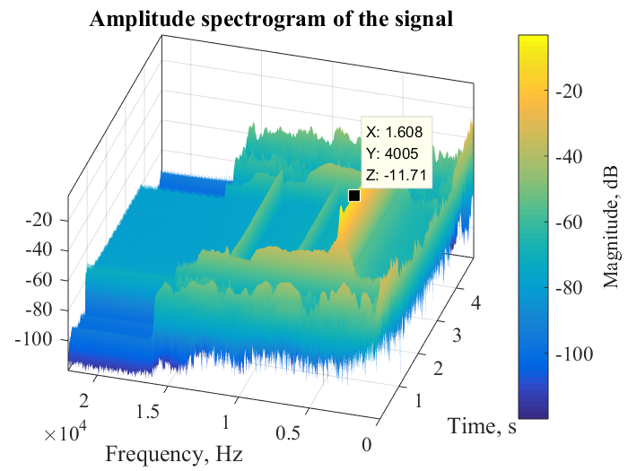
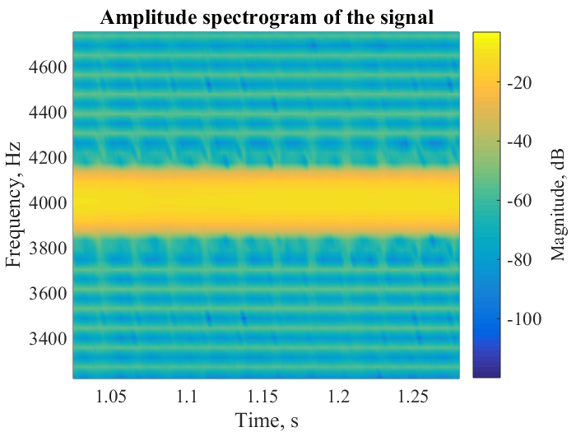
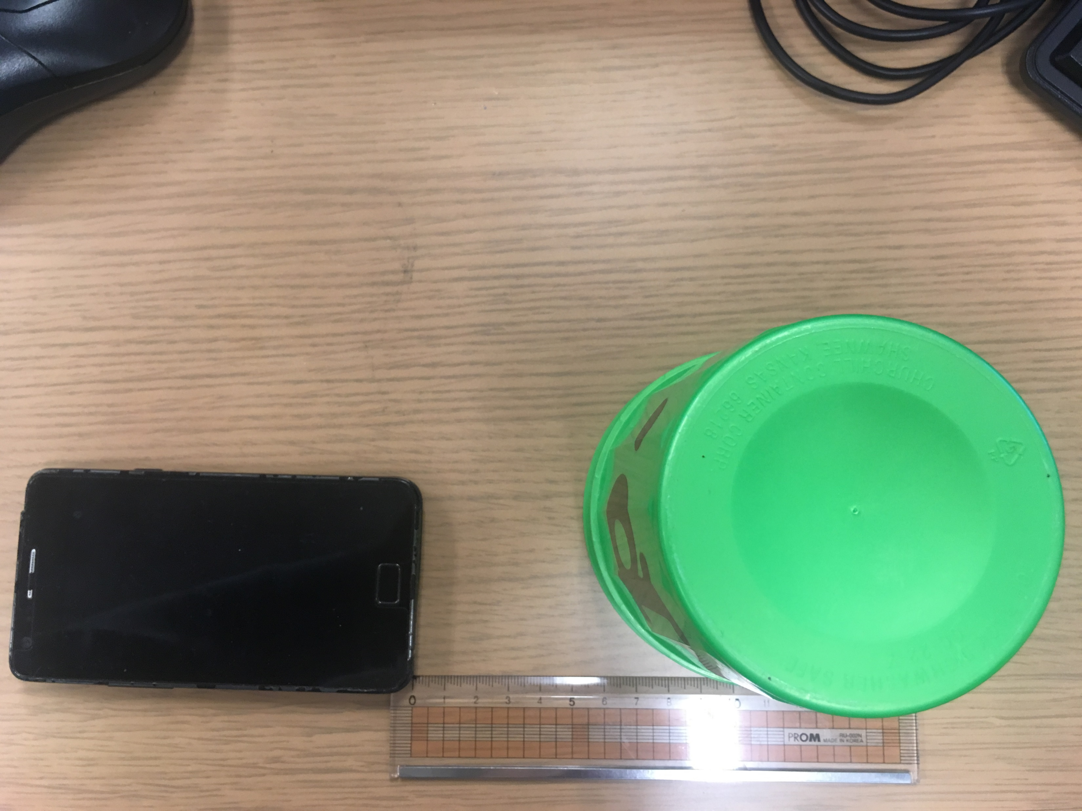

Preliminary study
To check the program of STFT algorithm
Find noise frequency area
Solution to remove the noise :
Low pass fitter (LPF)
using two microphones
Noise
[4,000Hz sound made by smartphone]
Recording Data
(Time Domain)
FFT result
(Freq. Domain)
STFT result
(Time&Freq).

Slide 17
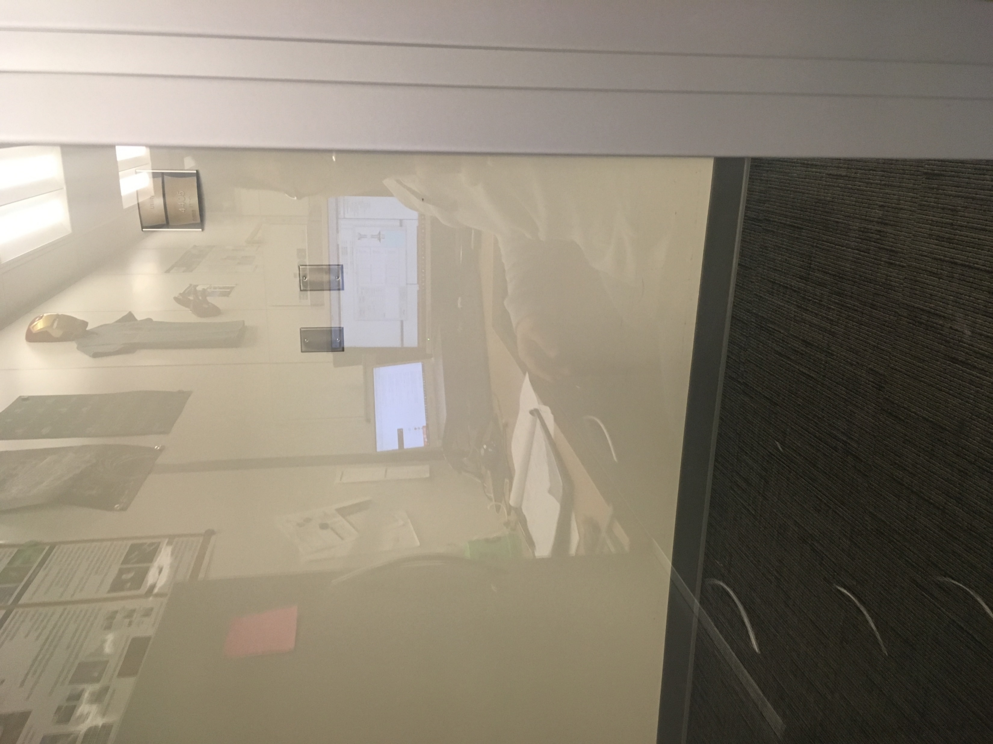


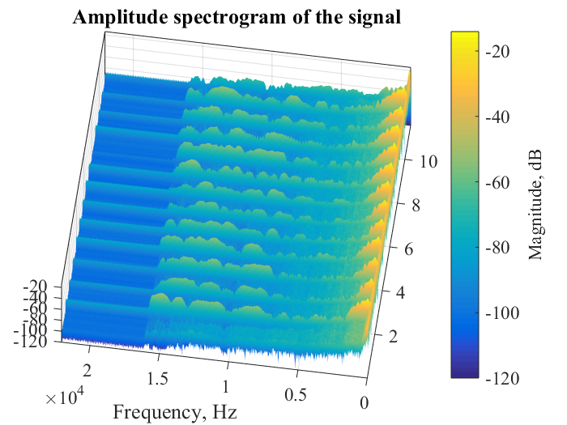
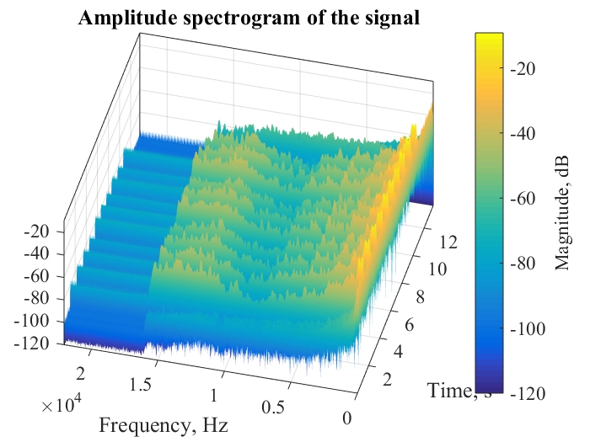
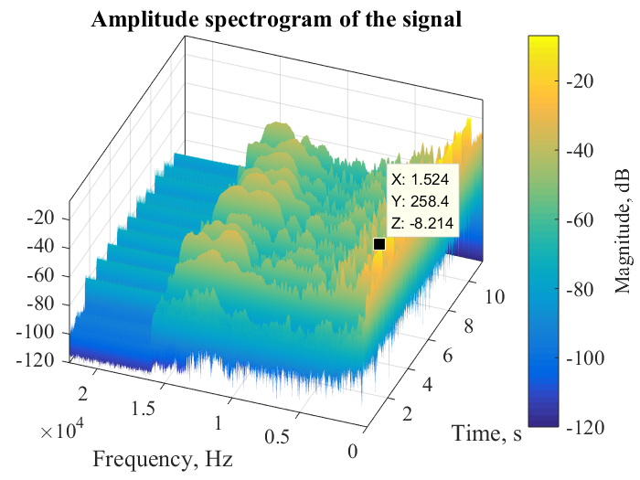
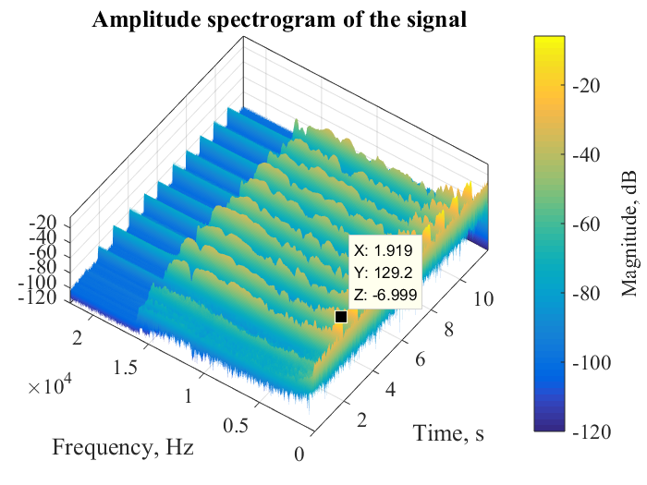
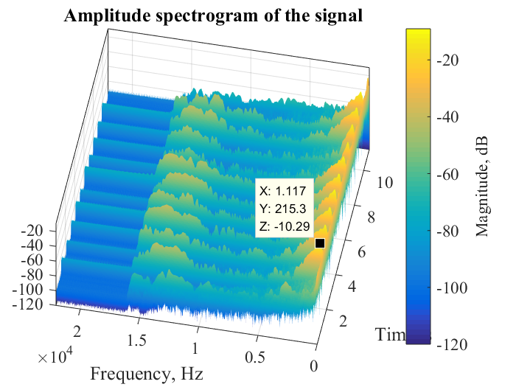
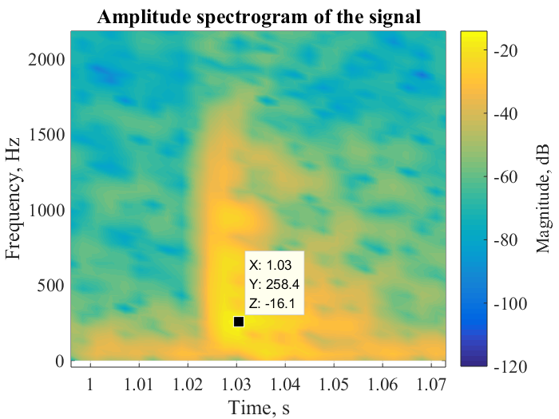
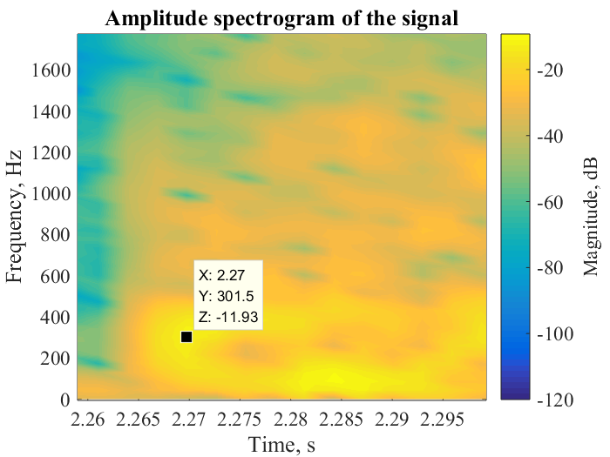
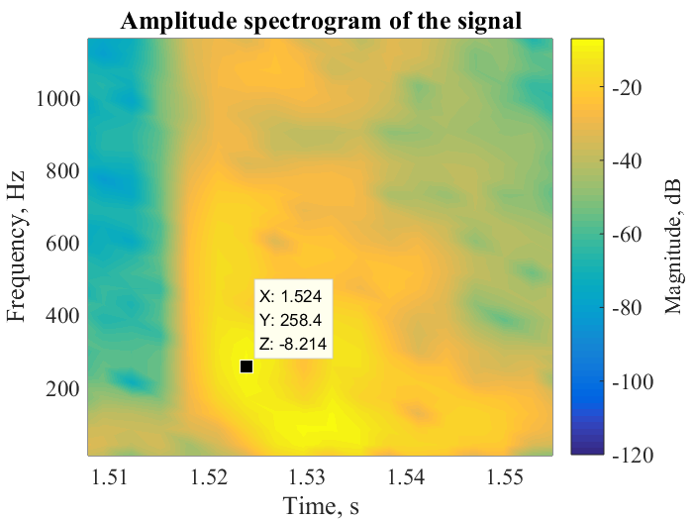
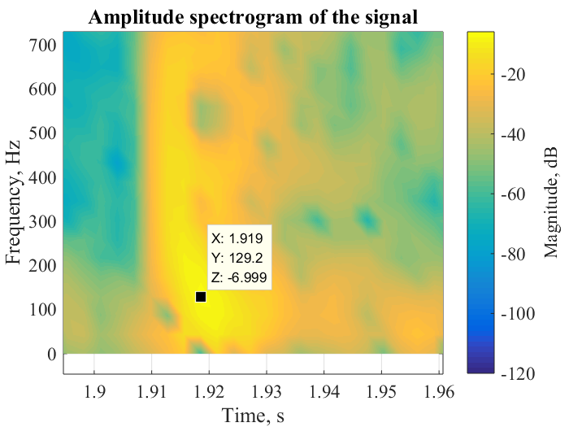
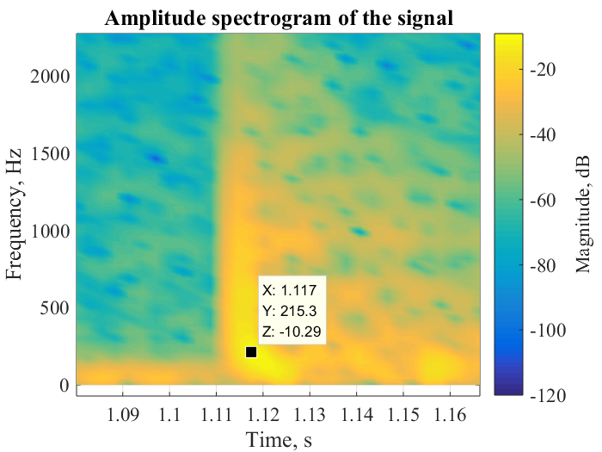
Preliminary study
[Wood(258hz)]
[Metal(301.5Hz)]
[Plastic(258Hz)]
[Paper(129.2Hz)]
[Window(215.3Hz)]

Slide 18

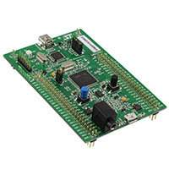
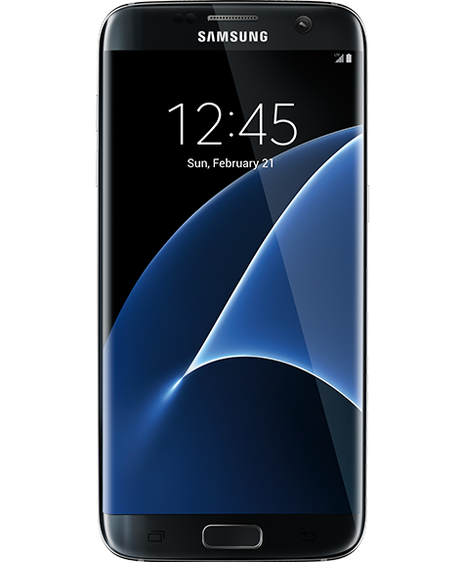
Component List
Electret Microphone Breakout
STM32F4-DISCO(32bit MCU)
Bluetooth Module
Android Smart Phone
https://www.sparkfun.com
http://www.firmtech.co.kr/

Slide 19

Development Plan

Slide 20
Reference
[1] http://www.afb.org/info/blindness-statistics/adults/special-report-on-aging-and-vision-loss/235
[2] Yongsik Jin, Jonghong Kim, Bumhwi Kim, Rammohan Mallipeddi, Minho Lee, Smart Cane: Face Recognition System for Blind
[3] https://en.wikipedia.org/wiki/Fast_Fourier_transform
[4] https://en.wikipedia.org/wiki/Short-time_Fourier_transform
[5] https://www.sparkfun.com/products/12758
[6]http://www.firmtech.co.kr/default/product/bluetooth/fb755ac.php

